Slide 1
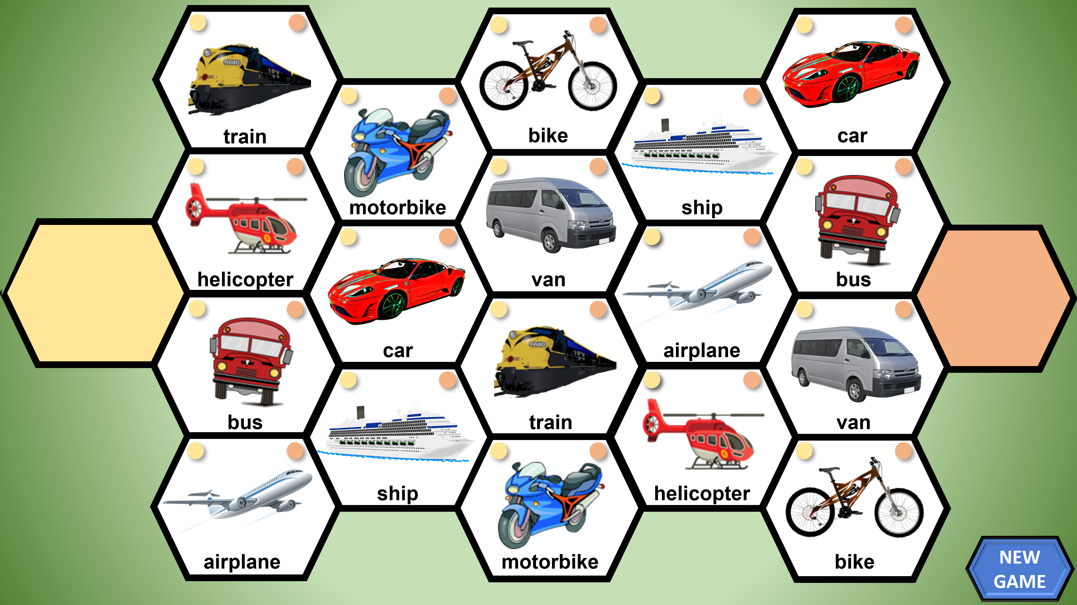
The Hexagon Game
A game template for learning English
And many other subjects

Slide 2
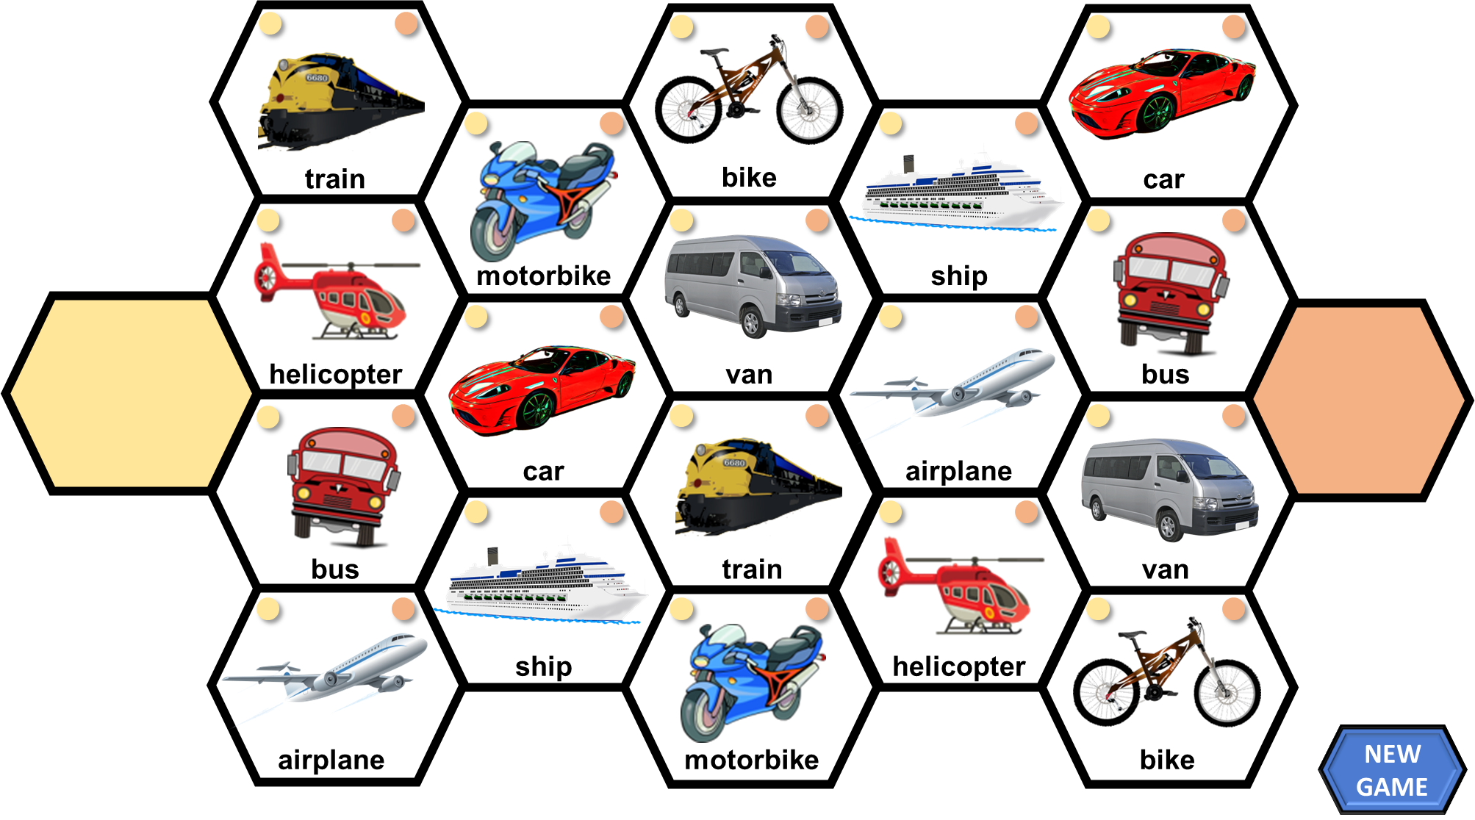
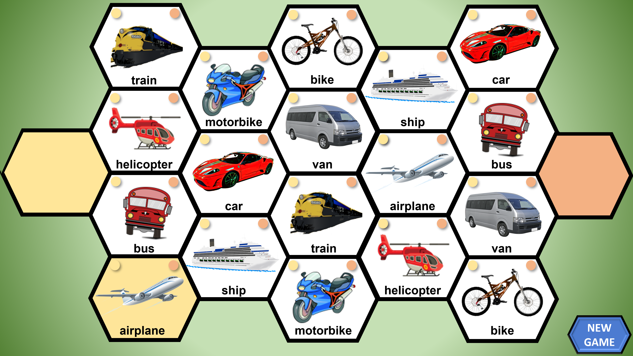
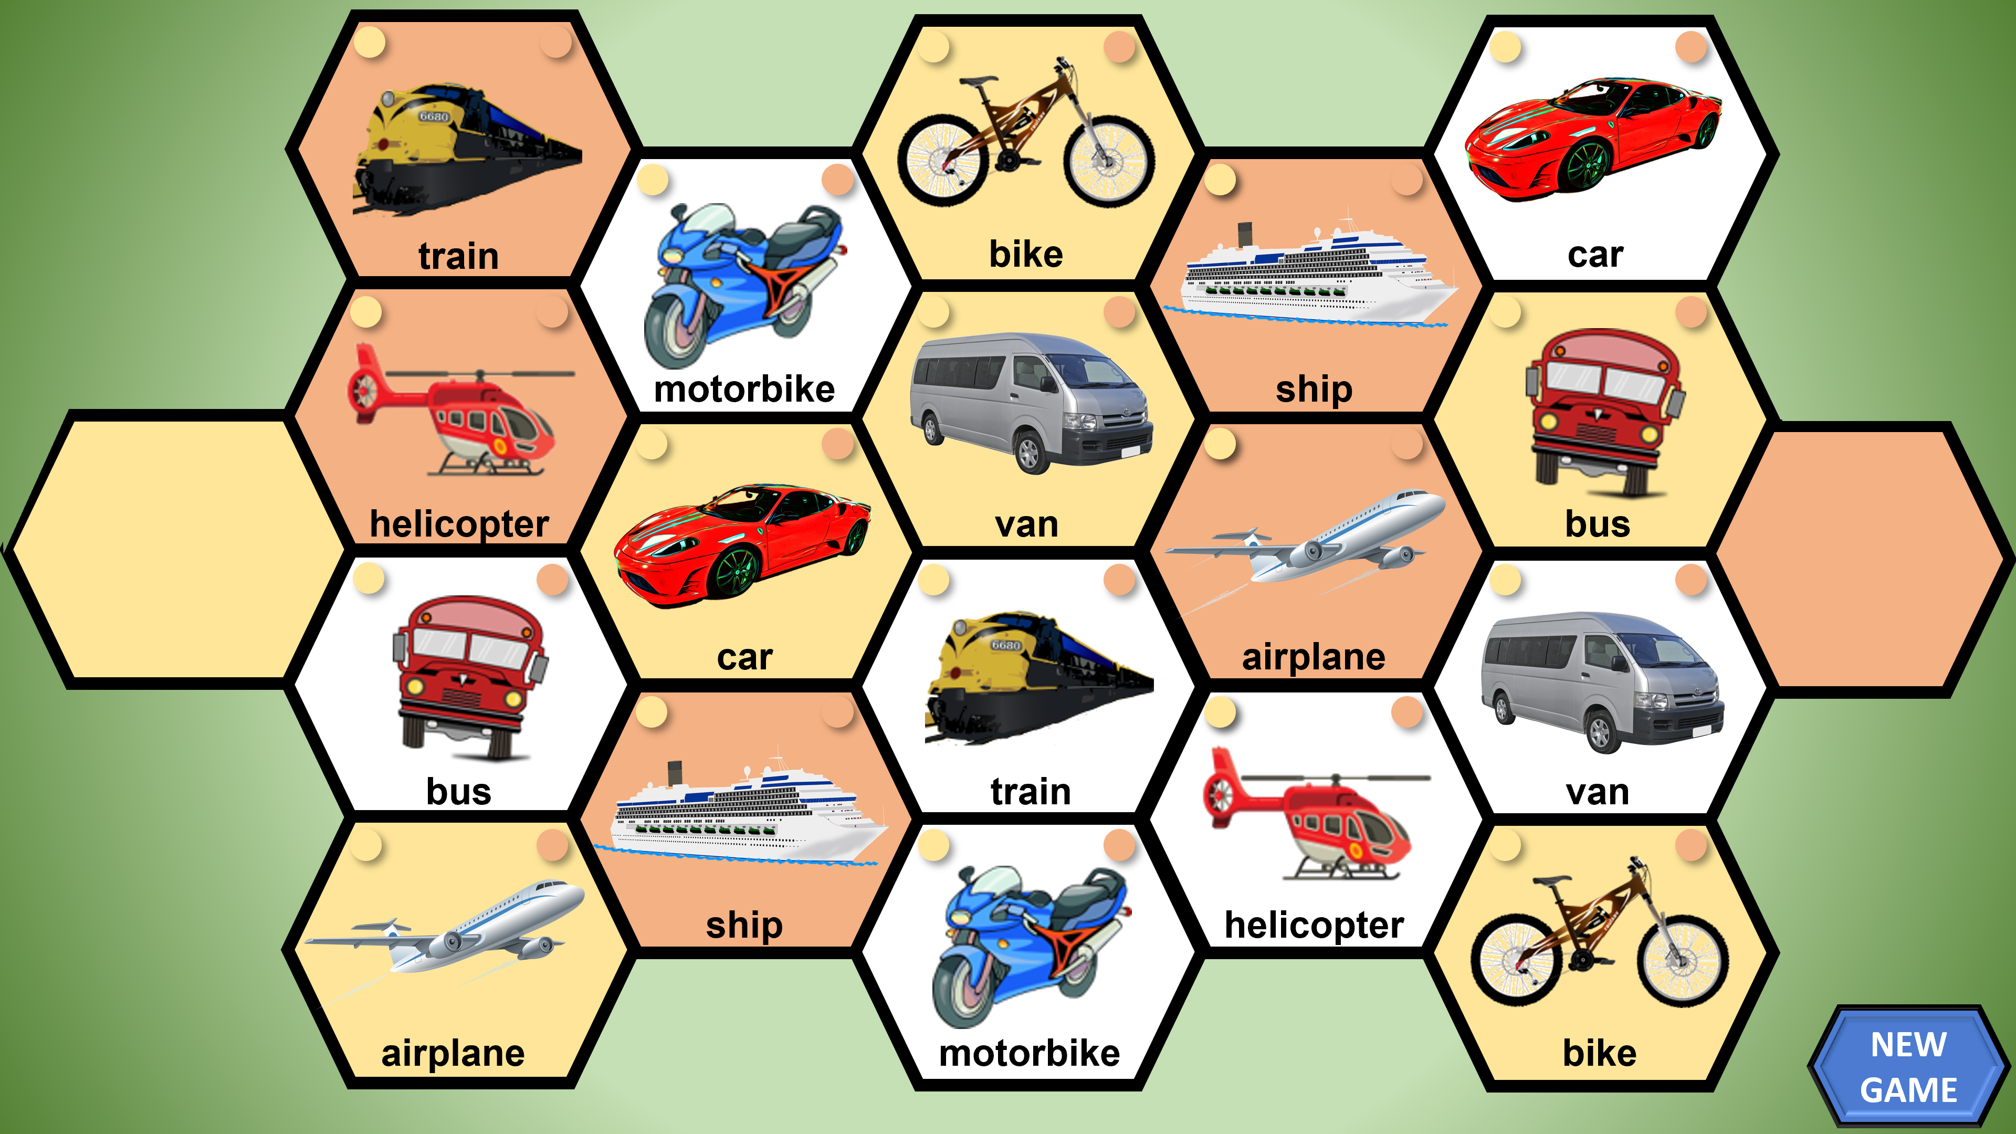
The Hexagon Game – instructions
A game for 2 players / teams (Yellow / Orange)
Click anywhere in the first player’s / team’s coloured hexagon. This will randomly trigger one hexagon to be highlighted (e.g ‘airplane’ in this example)
The student is given their task / question and if they answer correctly, you click on the small circular button at the top of that hexagon that denotes their colour.
The hexagon fill-colour will change accordingly and the highlight will disappear.
If a player selects a hexagon filled with their opponents colour, they can click on their own button to ‘take it’ if they answer correctly.
As the game progresses, there will be fewer triggers to click in each player’s hexagon, so click when you see a ‘pointing finger’ . You can play until there are no more hexagons to be played, or until a time limit has been reached.
You can make up quite a few different rules for this game depending on the circumstances (including playing from side to side without using the random selector). It can also be adapted to use for many different subjects.
Add up the coloured hexagons to identify the winner (or first to cross to the other side).
Click on ‘New Game’ to start again from scratch.
You can replace the pictures and text on slide 5 with any others you choose. After doing so, you can take a screenshot to replace the picture on the title slide if you wish.
Slide 4 is the reset slide to start a new game.

Slide 3
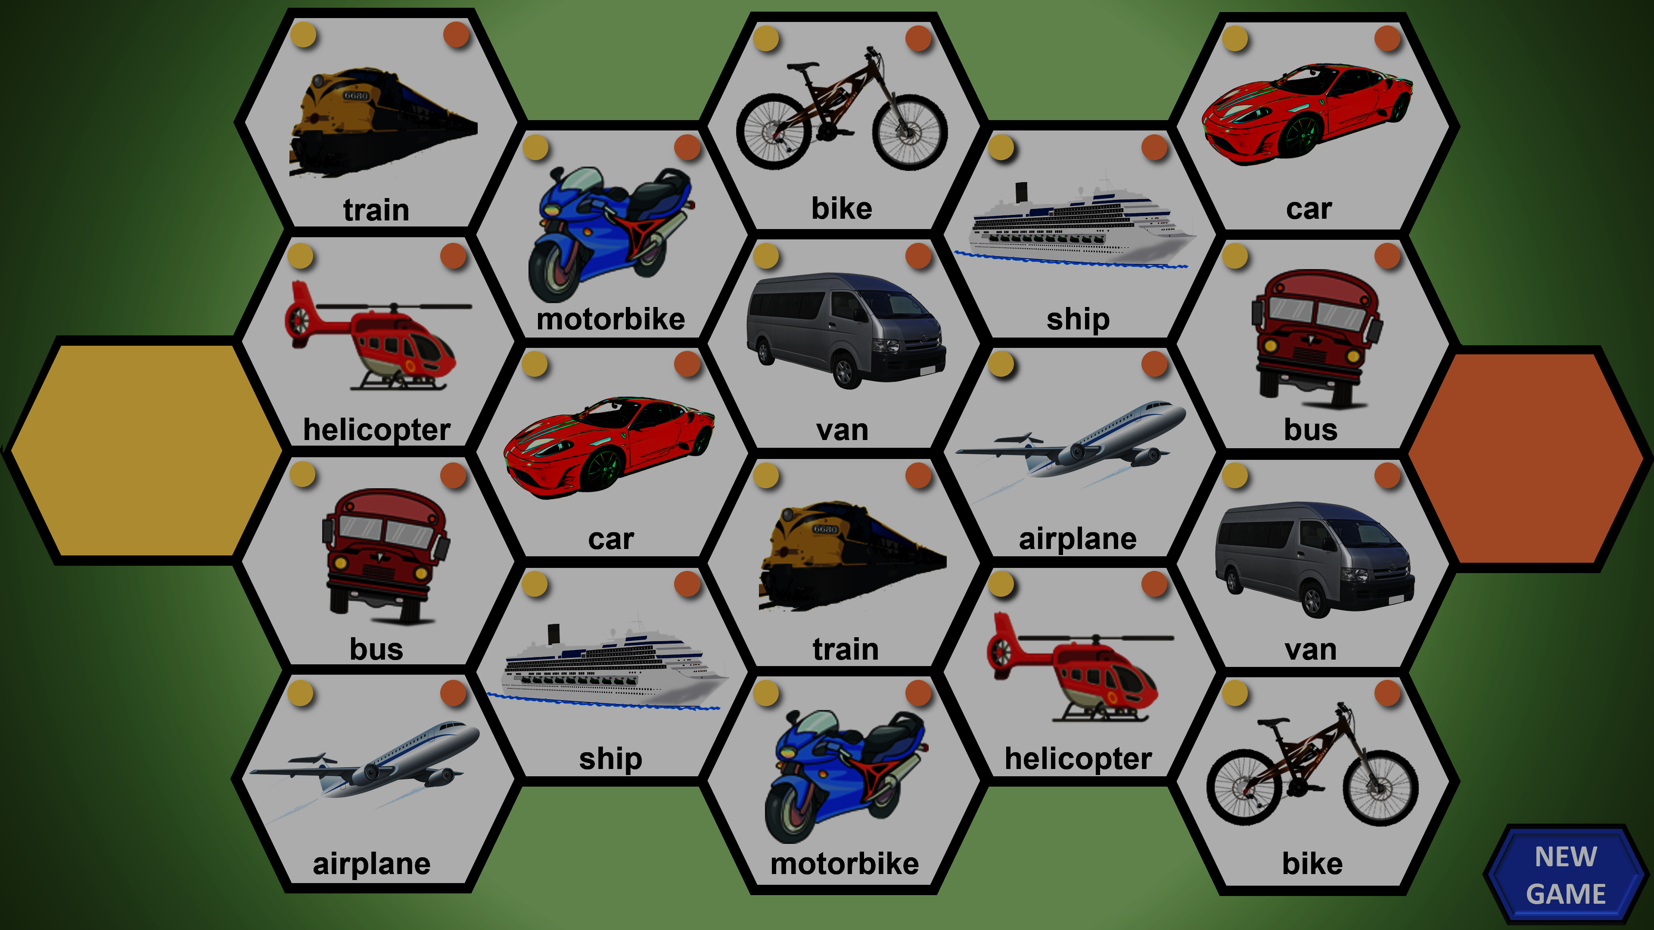
The Hexagon Game
ENTER SUBJECT HERE
PLAY

Slide 5
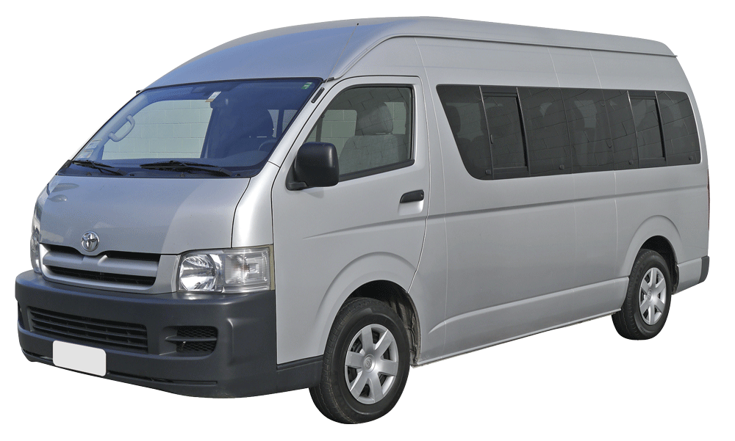
train
bike
car
motorbike
ship
helicopter
van
bus
car
airplane
bus
train
van
ship
helicopter
airplane
motorbike
bike
NEW GAME

