Slide 1
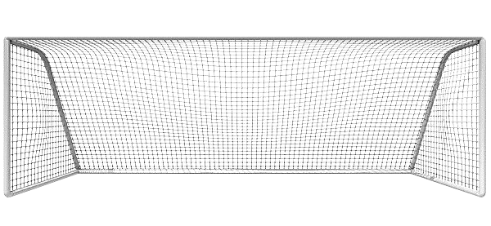
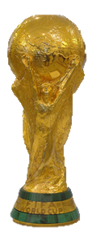
WORLD CUP
SHOOT-OUT!
HOW TO
PLAY
PLAY

Slide 2
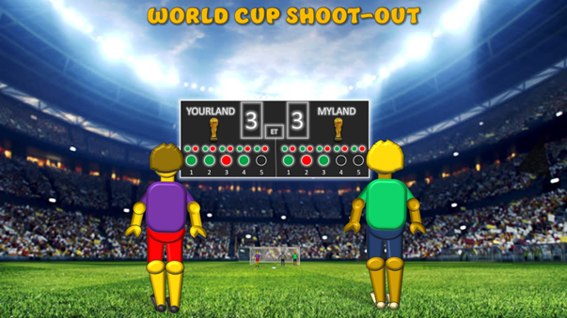
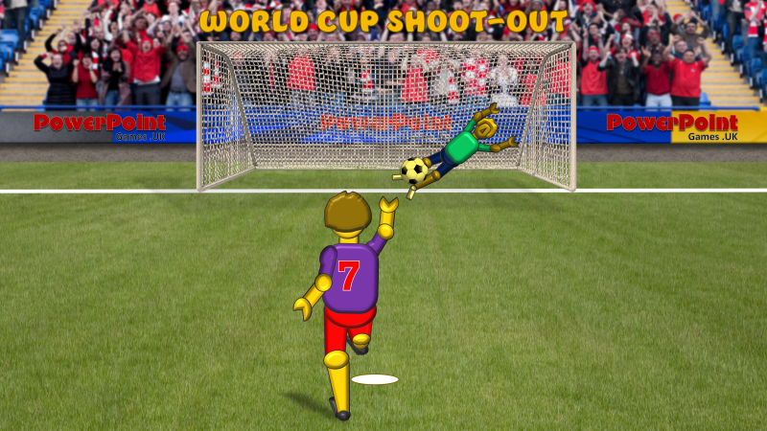
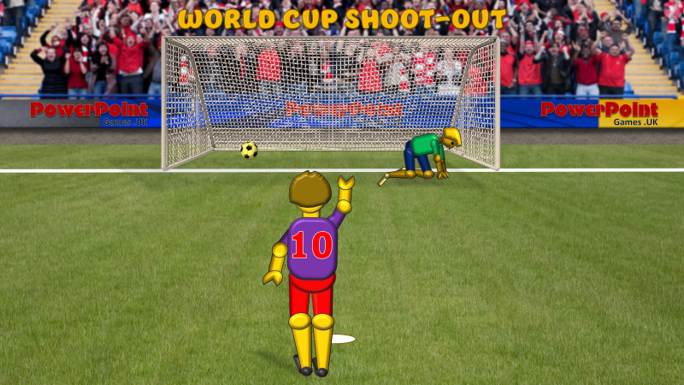
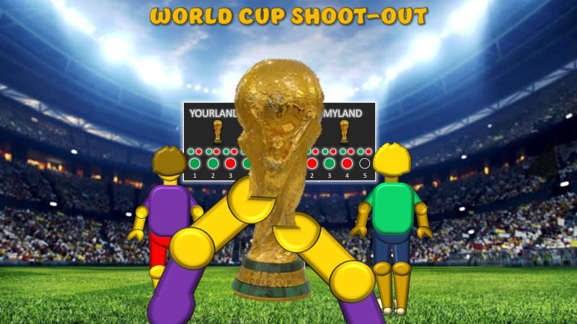
WORLD CUP SHOOT-OUT - INSTRUCTIONS
It’s the World Cup Final and after 90 minutes plus 30 minutes extra time, the match is drawn at 3 goals each.
So now it’s time for the penalty shoot out!
1. Establish who will be purple and green and who will go first
5. Click on the relevant small oval on the scoreboard.
Green = scored
Red = missed / saved
2. From the scoreboard slide, the first player clicks on the back of their figure. This will link to a ‘Penalty’ slide.
6. The winner of the round will be the player with the highest number of scored penalties after both players have taken five penalties.
7. In the event of a draw, play ‘sudden death’. Click on the slide title to re-set the game. Take the penalties in the same way until one team achieves a 2 goal advantage – and win the World Cup.
8. Click on the cup above the relevant scoreboard for the cup to be raised.
3. Click on the back of the penalty-taking figure for the penalty to be taken.
4. The penalty will be either scored, missed, or saved. When it has been taken, click on the slide title to go back to the scoreboard.
PLAY

Slide 3
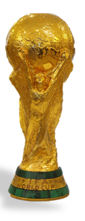
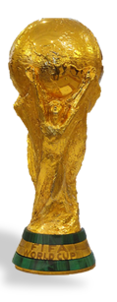
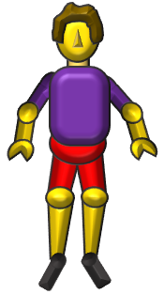
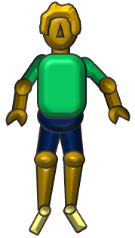
WORLD CUP SHOOT-OUT
YOURLAND
3
3
MYLAND
ET
1
2
3
4
5
1
2
3
4
5

Slide 4
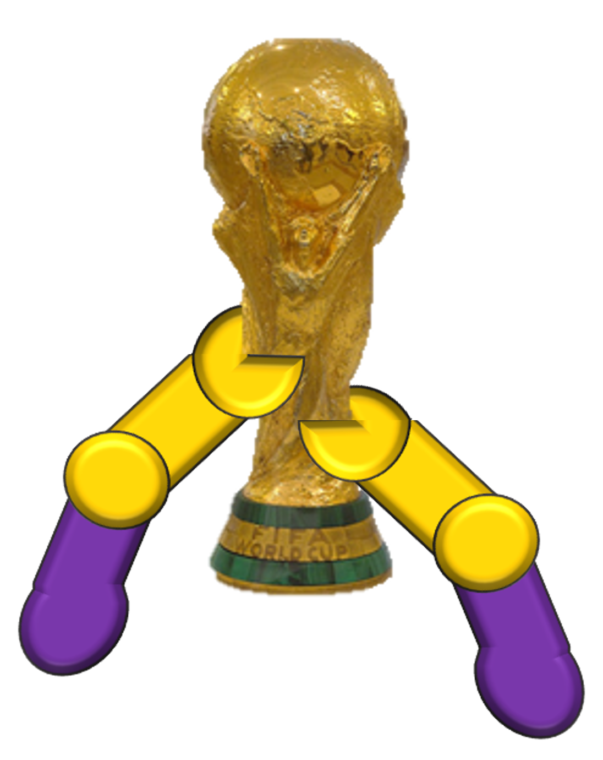
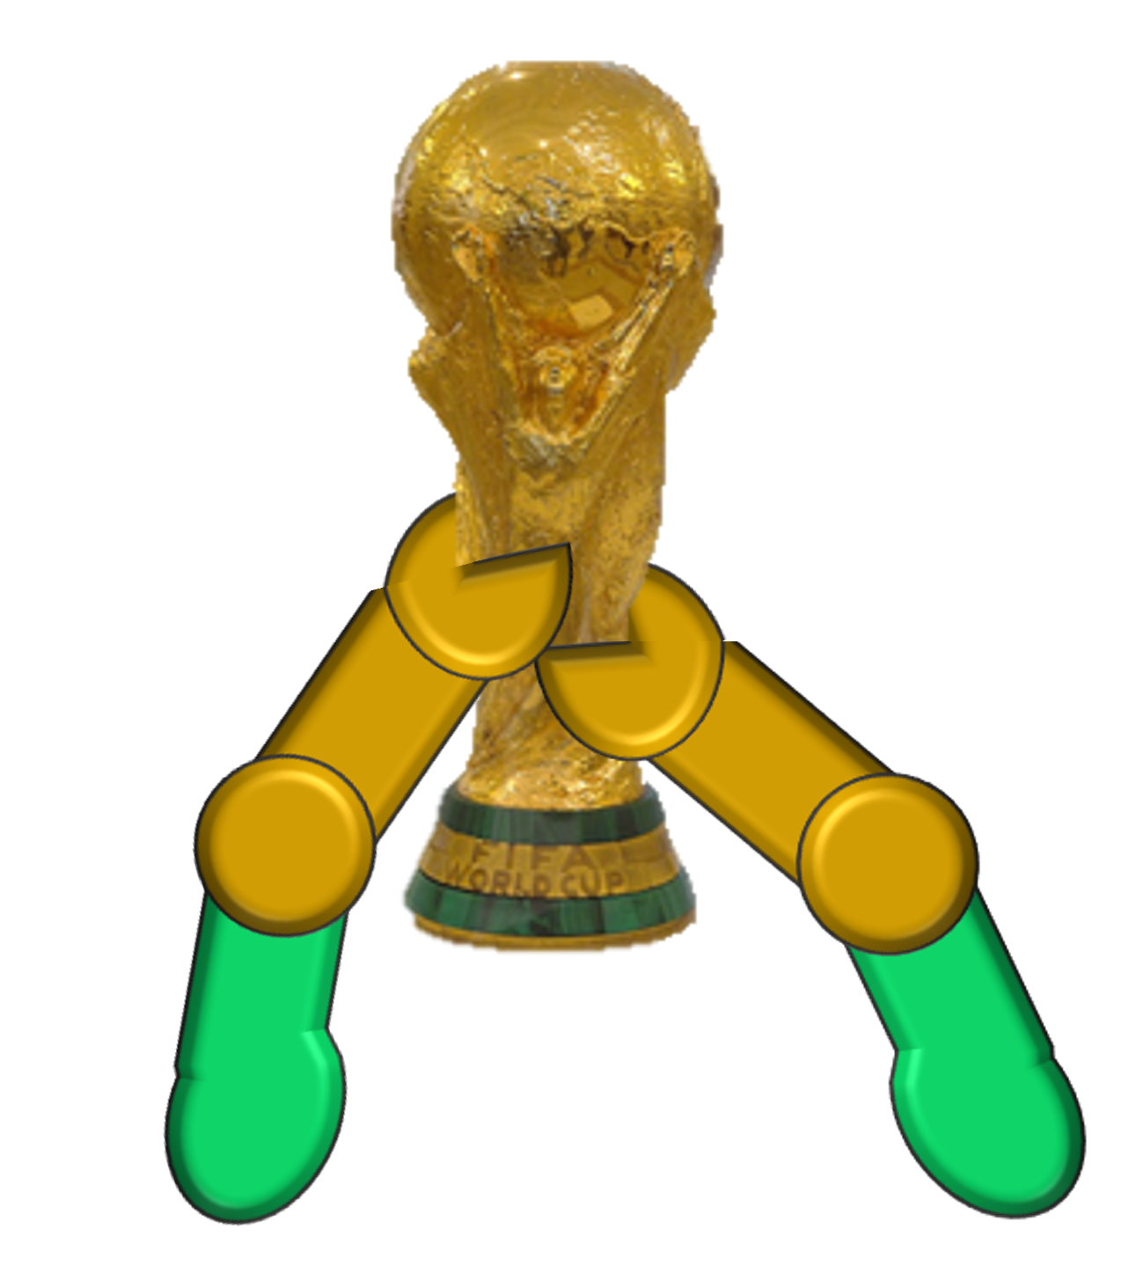
WORLD CUP SHOOT-OUT
YOURLAND
3
3
MYLAND
ET
1
2
3
4
5
1
2
3
4
5

Slide 5
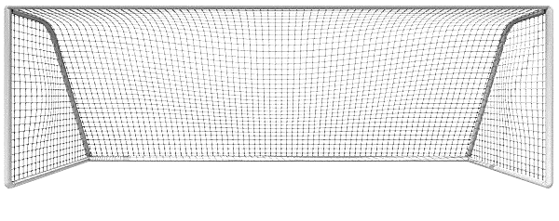
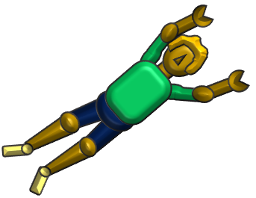
WORLD CUP SHOOT-OUT
7

Slide 6
WORLD CUP SHOOT-OUT
7

Slide 7
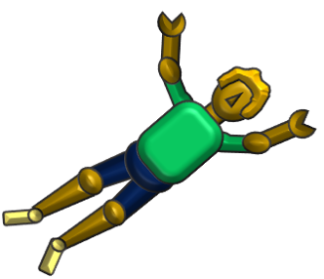
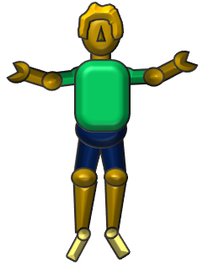
WORLD CUP SHOOT-OUT
8

Slide 8
WORLD CUP SHOOT-OUT
8

Slide 9
WORLD CUP SHOOT-OUT
9

Slide 10
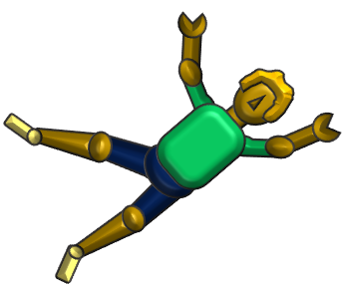
WORLD CUP SHOOT-OUT
9

Slide 11
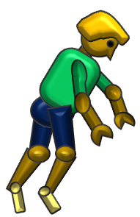
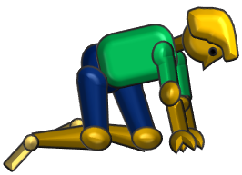
WORLD CUP SHOOT-OUT
10

Slide 12
WORLD CUP SHOOT-OUT
10

Slide 13
WORLD CUP SHOOT-OUT
11

Slide 14
WORLD CUP SHOOT-OUT
11

Slide 15
WORLD CUP SHOOT-OUT
8

Slide 16
WORLD CUP SHOOT-OUT
8

Slide 17
WORLD CUP SHOOT-OUT
7

Slide 18
WORLD CUP SHOOT-OUT
7

Slide 19
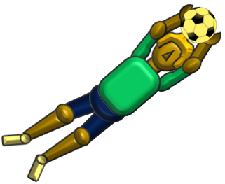
WORLD CUP SHOOT-OUT
10

Slide 20
WORLD CUP SHOOT-OUT
10

Slide 21
WORLD CUP SHOOT-OUT
9

Slide 22
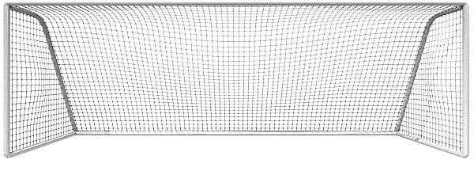
WORLD CUP SHOOT-OUT
9

Slide 23
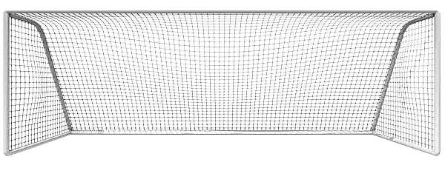
WORLD CUP SHOOT-OUT
11

Slide 24
WORLD CUP SHOOT-OUT
11

Slide 25
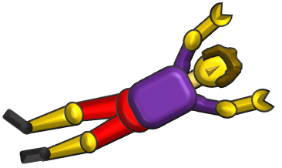
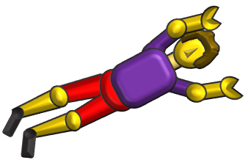
WORLD CUP SHOOT-OUT
5

Slide 26
WORLD CUP SHOOT-OUT
5

Slide 27
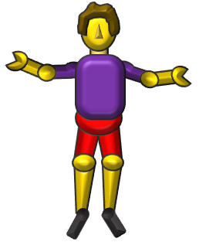
WORLD CUP SHOOT-OUT
14

Slide 28
WORLD CUP SHOOT-OUT
14

Slide 29
WORLD CUP SHOOT-OUT
6

Slide 30
WORLD CUP SHOOT-OUT
6

Slide 31
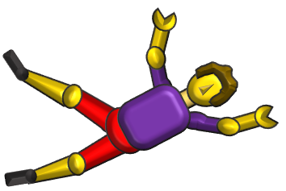
WORLD CUP SHOOT-OUT
4

Slide 32
WORLD CUP SHOOT-OUT
4

Slide 33
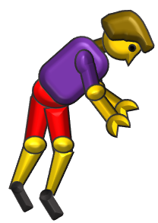
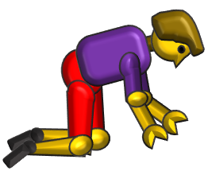
WORLD CUP SHOOT-OUT
11

Slide 34
WORLD CUP SHOOT-OUT
11

Slide 35
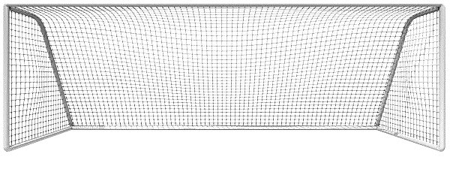
WORLD CUP SHOOT-OUT
5

Slide 36
WORLD CUP SHOOT-OUT
5

Slide 37
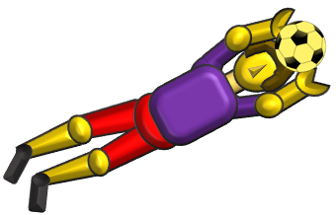
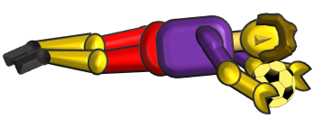
WORLD CUP SHOOT-OUT
14

Slide 38
WORLD CUP SHOOT-OUT
14

Slide 39
WORLD CUP SHOOT-OUT
6

Slide 40
WORLD CUP SHOOT-OUT
6

Slide 41
WORLD CUP SHOOT-OUT
4

Slide 42
WORLD CUP SHOOT-OUT
4

Slide 43
WORLD CUP SHOOT-OUT
11

Slide 44
WORLD CUP SHOOT-OUT
11

