Slide 1
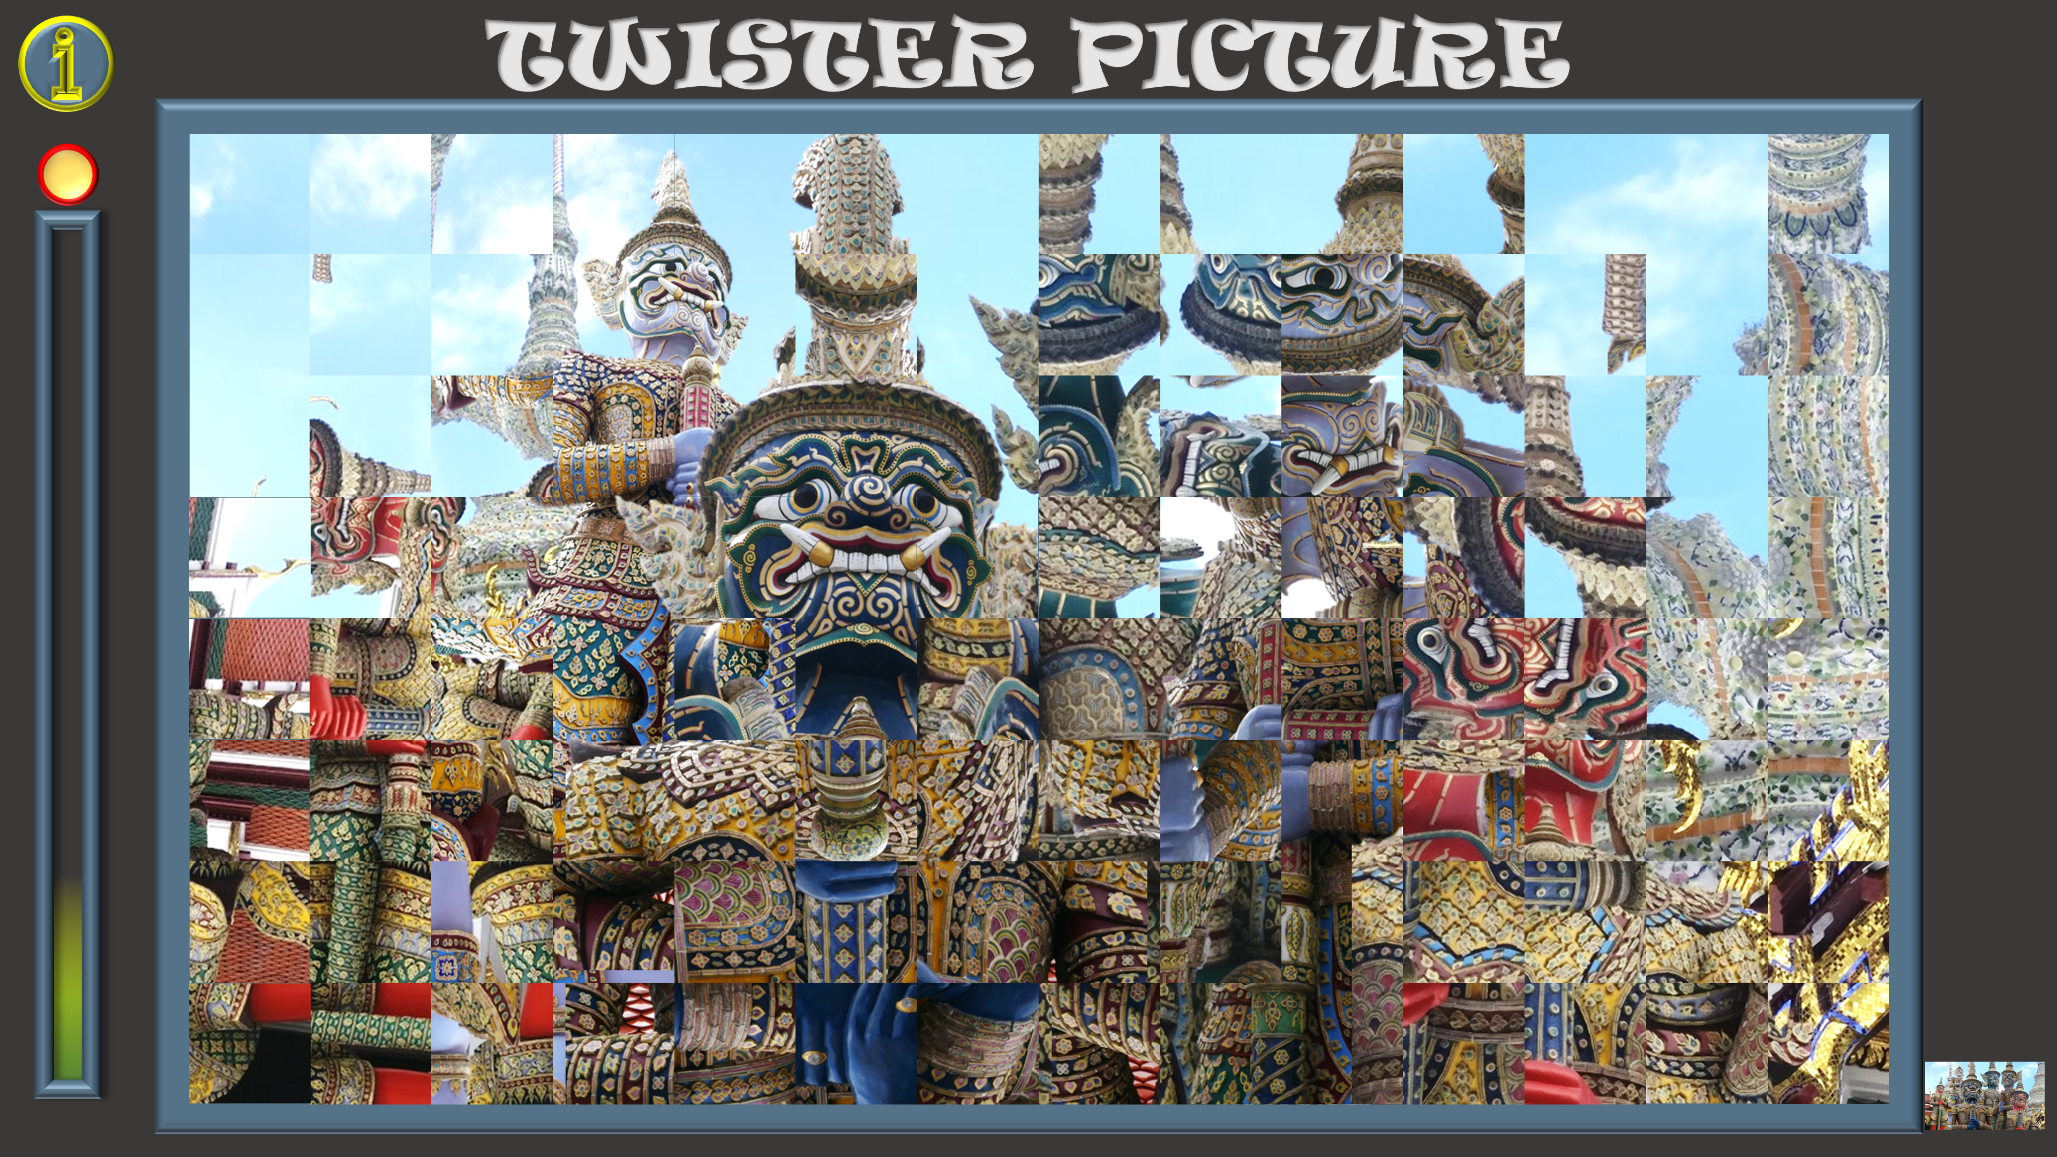
TWISTER PICTURE
1. Click on the gold button to start the game, and the timer.
4. After 5 minutes the timer will chime and no more clicks will be possible. But…
2. Click on the picture squares to turn them 90 degrees until they are in the right position.
5. If you want to continue turning the squares until the picture is complete, click on the gold button again.
3. Click on the picture at the bottom right of the screen to see how the completed picture looks – Click again to return to the playing slide .
Click here to return to the playing slide.

Slide 2
TWISTER PICTURE

