Slide 1
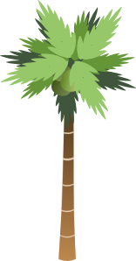
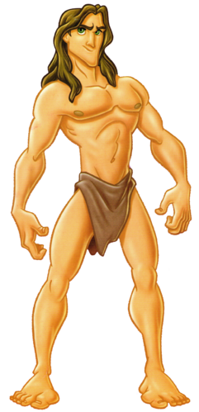
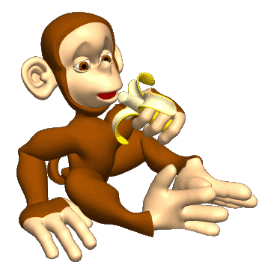
TARZAN
AND THE GREEDY MONKEY
HOW TO PLAY
PLAY

Slide 2
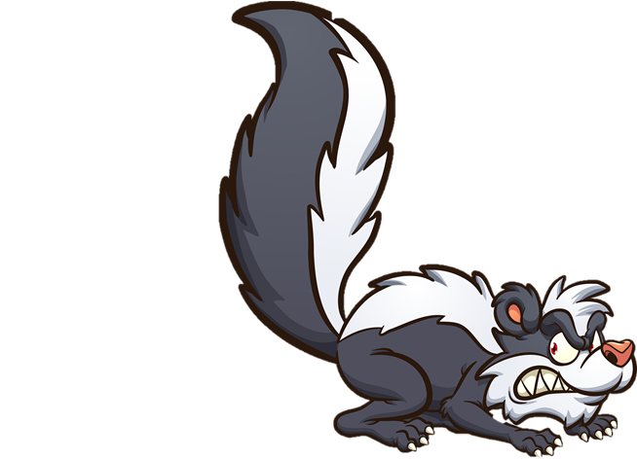
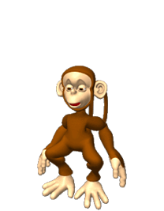
HOW TO PLAY
AND THE GREEDY MONKEY
TARZAN
INCORRECT
The aim of the game is for a team (or individual) to answer six questions correctly to help Tarzan stop the greedy monkey from eating all the bananas on Banana Island.
BUT…Answer two questions incorrectly – and it’s Game Over!!
CORRECT
TO PLAY:
1. Establish the teams and the running order
2. Ask the first team the first of their six questions
3. If they answer correctly, click on the ‘CORRECT’ bunch of bananas and ask them their next question – and so on.
4. If they answer incorrectly, click on the ‘INCORRECT’ bunch of bananas and ask them their next question
5. Win or lose, click on the ‘NEXT’ sign when it appears for the next team’s turn
PLAY

Slide 3
TARZAN
AND THE GREEDY MONKEY

Slide 4
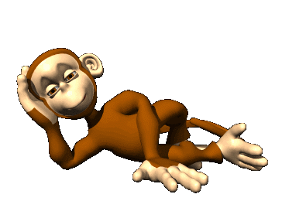
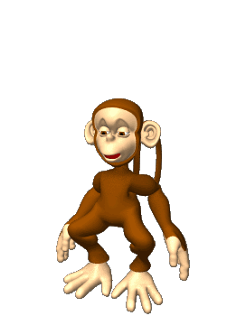
NEXT?

