Slide 1
DOOBLE
HOW TO
PLAY
PLAY
A GAME FOR UP TO 4 PLAYERS

Slide 2
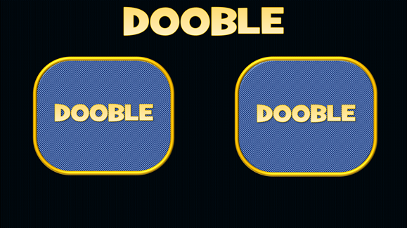
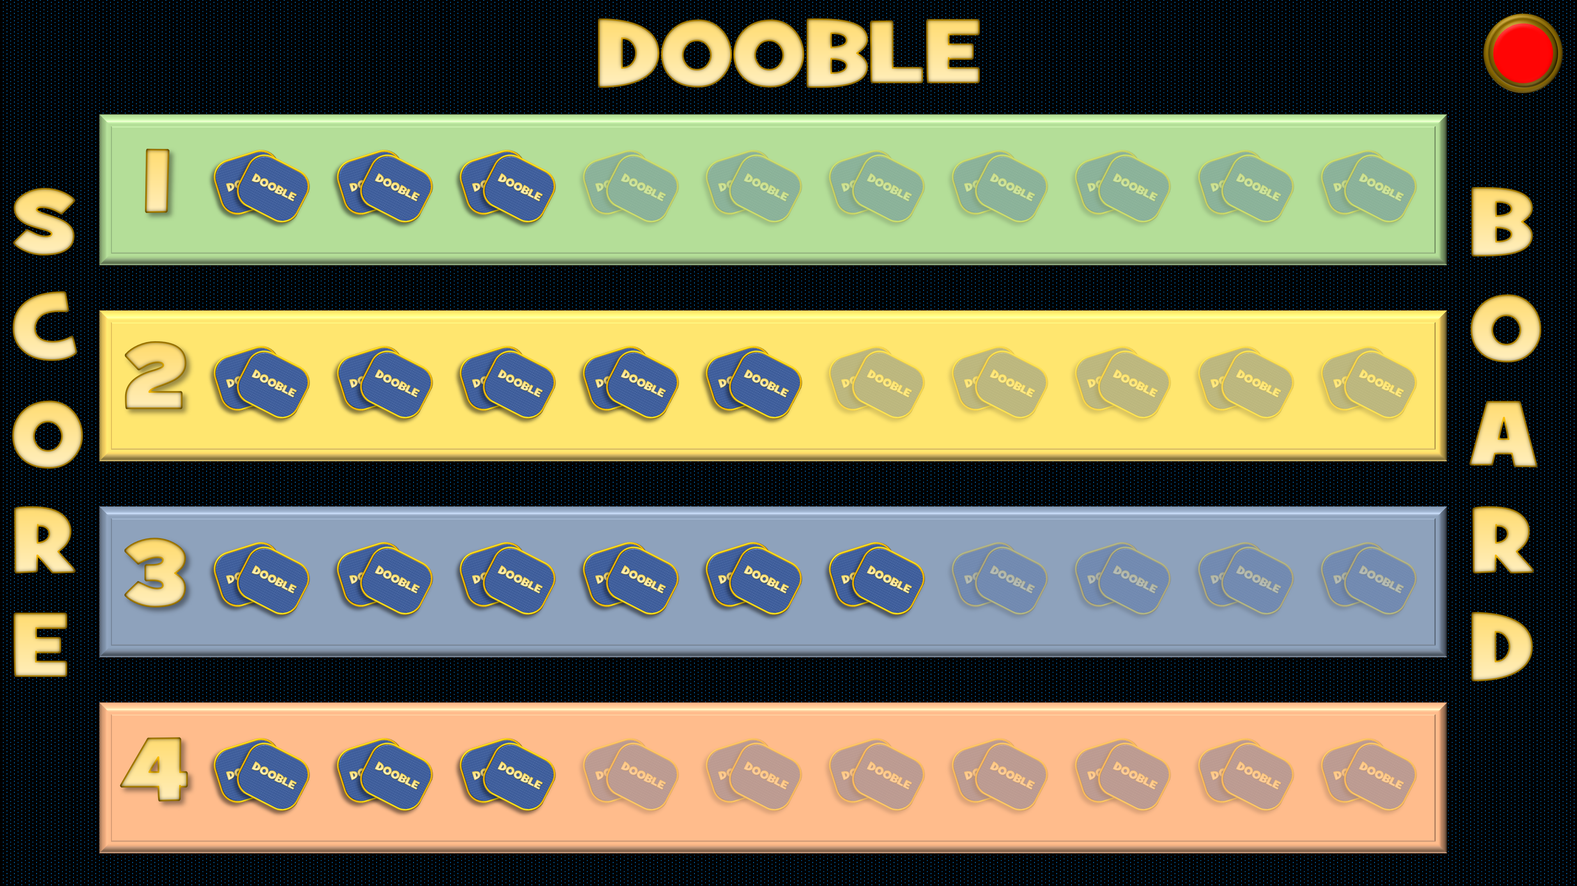
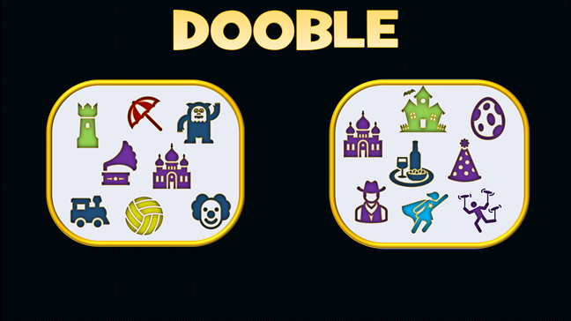
HOW TO
PLAY
PLAY
4. The winning player clicks on a faded pair of cards to register their win
1. Click on the 2 card backs to reveal the playing cards.
2. The first player to shout out the name of the object that appears on both cards wins
5. Click on the Dooble title to go back to the playing screen.
(The first player to achieve 10 wins is the overall winner)
3. Click on the Dooble title to open the Scoreboard
6. Click on the red button in the corner to reset the scoreboard if needed
Press ‘Esc’ on your keyboard to exit the game at any time

Slide 3
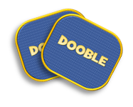
DOOBLE
1
SCORE
BOARD
2
3
4

Slide 4
DOOBLE
DOOBLE
DOOBLE

Slide 5
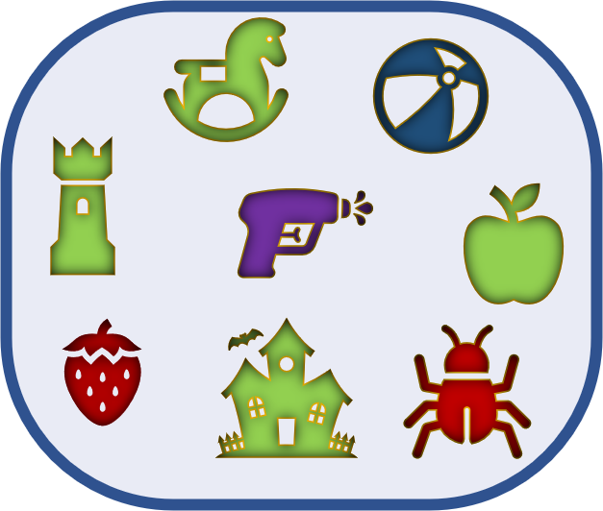
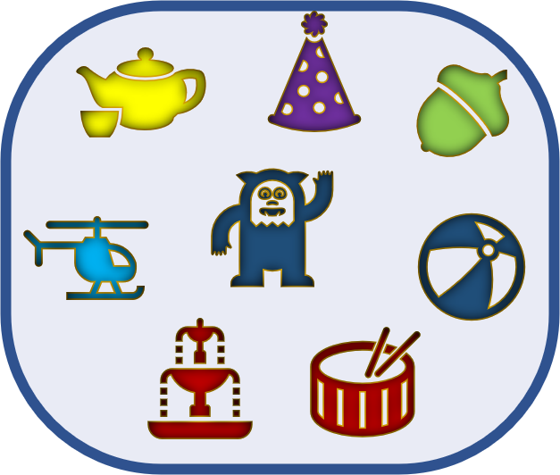
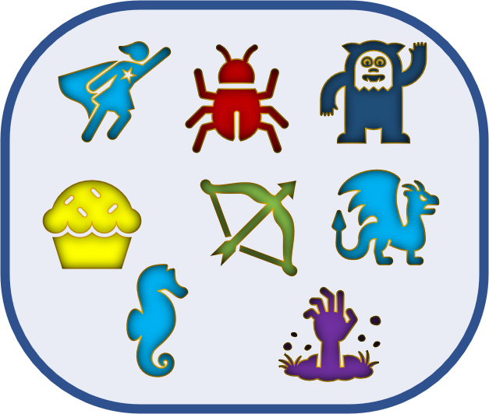
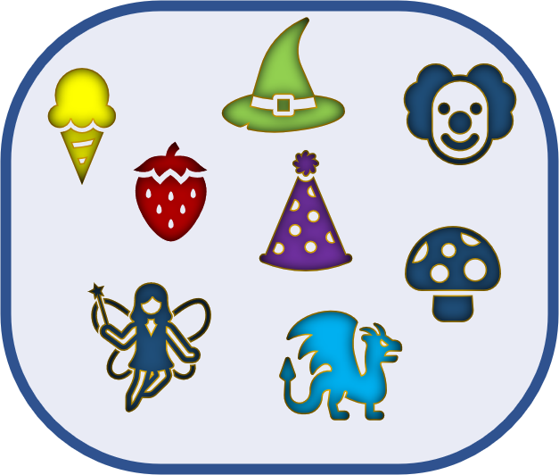
DOOBLE
DOOBLE
DOOBLE

