Slide 1
DOOBLE
SOLO
HOW TO PLAY
PLAY

Slide 2
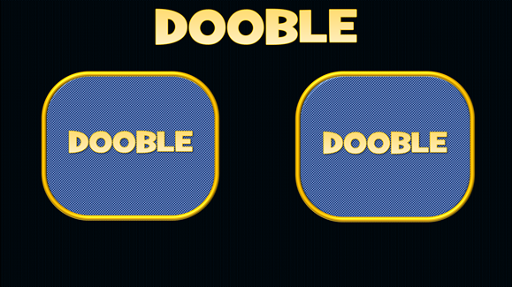
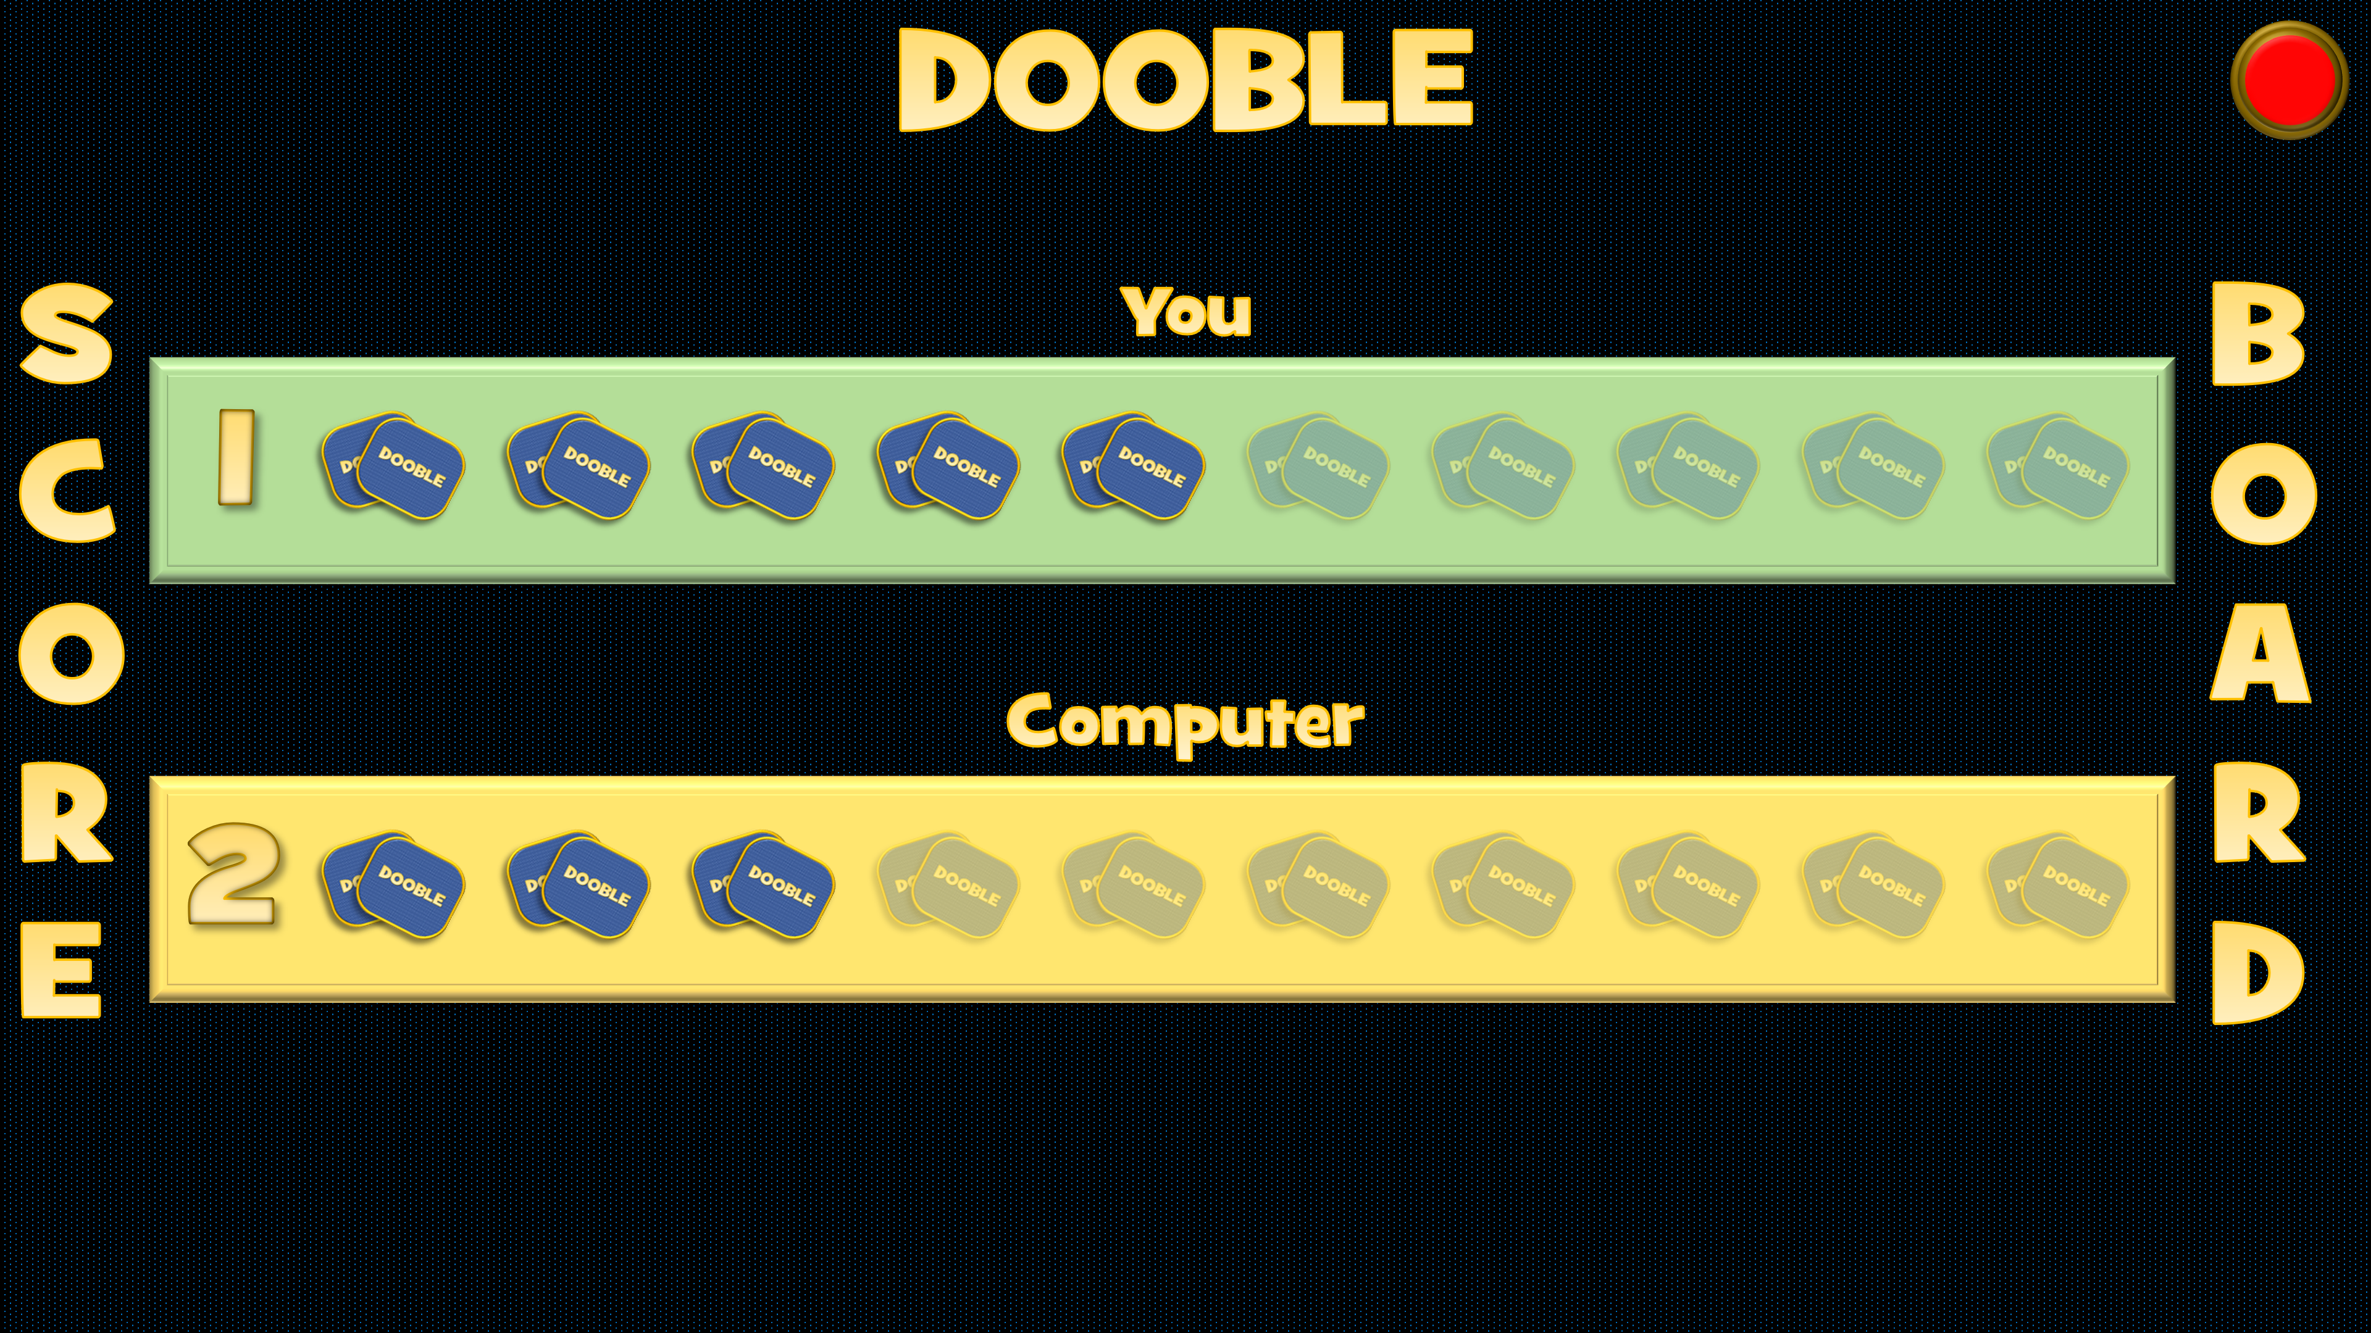
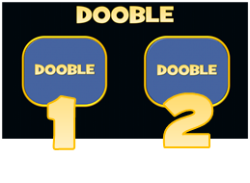
HOW TO PLAY
PLAY
1. Click on the 2 card backs to reveal the playing cards.
4. You are player 1. The computer is Player 2. Click on a faded pair of cards to register who has won each round.
Click in this order:
2. When you identify the object that appears on both cards, click on your Green button. If you do not click on this within 5 seconds of clicking card 2, a red light will appear and the computer will win the round.
5. Click on the Dooble title to go back to the playing screen.
The first player (you or the computer) to achieve 10 wins is the overall winner.
3. Click on the Dooble title to open the Scoreboard.
6. Click on the red button in the corner to reset the scoreboard if needed.
Press ‘Esc’ on your keyboard to exit the game at any time

Slide 3
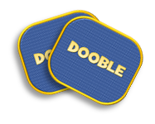
DOOBLE
SCORE
You
BOARD
1
Computer
2

Slide 4
DOOBLE
DOOBLE
DOOBLE

Slide 5
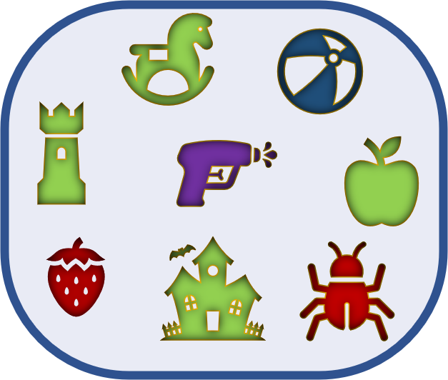
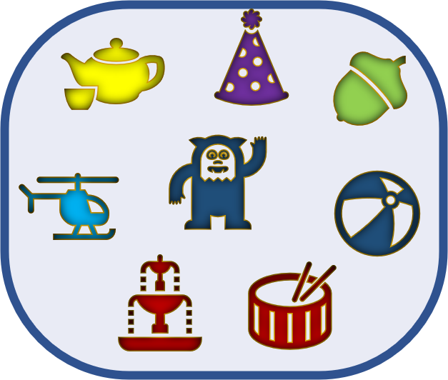
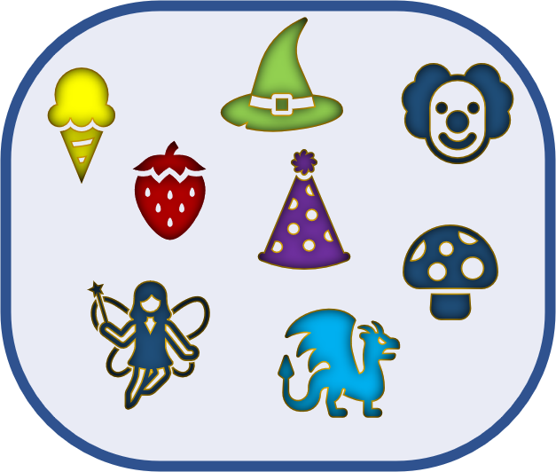
DOOBLE
DOOBLE
DOOBLE

