Slide 1
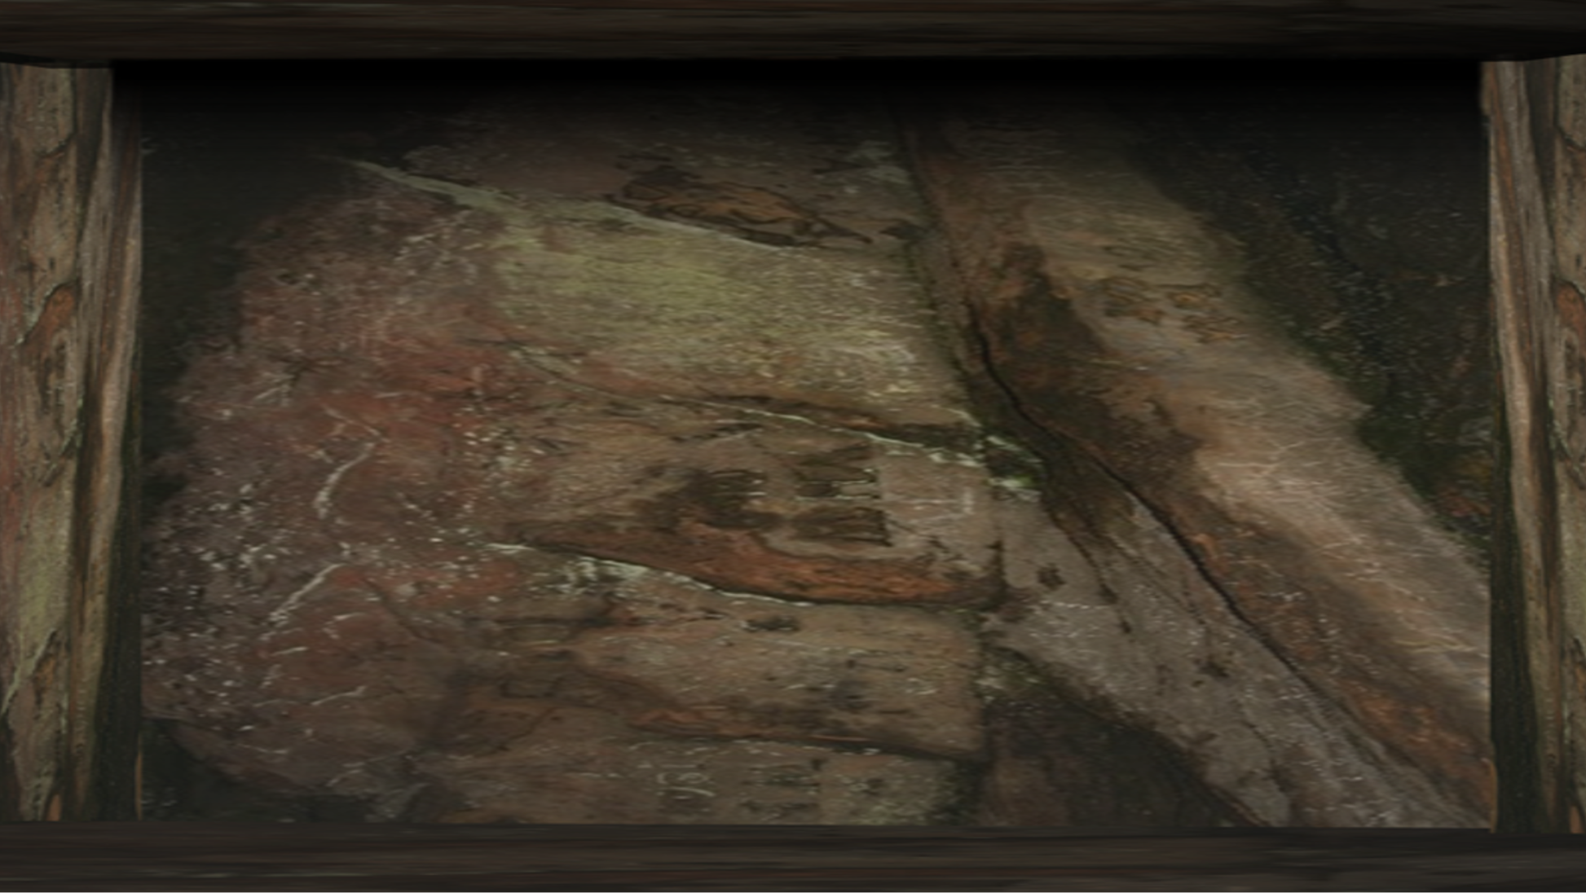
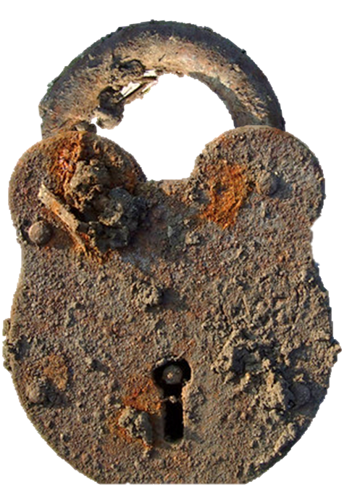
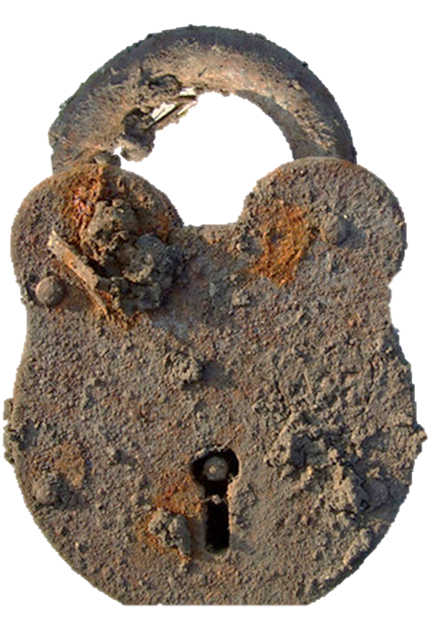
THE
DUNGEONS
OF
HORYD HOUSE
HOW TO PLAY
PLAY

Slide 2
You are now in the dungeons of Horyd House where some of the suspects from ‘Murder in Horyd House’ have been imprisoned.
None of them are guilty and your task is to help them escape.
All you have to do is click on the ONE master padlock of their cell window.
Use the first screen to check which padlocks will open the window bars. Memorise them. Click on ‘AGAIN’ if you want more practice.
Then click on ‘GO FOR IT’ to click on them for real.
If you succeed they will all escape and you can move on to the next dungeon.
If you fail you can go back to the practice screen and try again.
PLAY

Slide 3
MEMORISE THE LOCKS
AGAIN
GO FOR IT

Slide 4
MEMORISE THE LOCKS
AGAIN
GO FOR IT

Slide 5
GET THEM OUT!
AGAIN
NEXT

Slide 6
GET THEM OUT!
AGAIN
NEXT

Slide 7
MEMORISE THE LOCKS
AGAIN
GO FOR IT

Slide 8
MEMORISE THE LOCKS
GO FOR IT
AGAIN

Slide 9
GET THEM OUT!
AGAIN
NEXT

Slide 10
GET THEM OUT!
AGAIN
NEXT

Slide 11
MEMORISE THE LOCKS
AGAIN
GO FOR IT

Slide 12
MEMORISE THE LOCKS
AGAIN
GO FOR IT

Slide 13
GET THEM OUT!
AGAIN
NEXT

Slide 14
GET THEM OUT!
AGAIN
NEXT

Slide 15
MEMORISE THE LOCKS
AGAIN
GO FOR IT

Slide 16
MEMORISE THE LOCKS
AGAIN
GO FOR IT

Slide 17
GET THEM OUT!
AGAIN
FINISHED!

Slide 18
GET THEM OUT!
AGAIN
YOU’VE DONE IT - THEY HAVE ALL ESCAPED!!

