Slide 1
A GAME FOR UP TO 4 PLAYERS
HUNGRY
HIPPOS
HOW TO
PLAY
PLAY

Slide 2
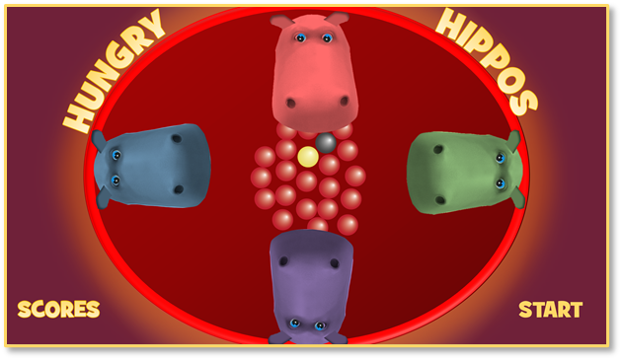
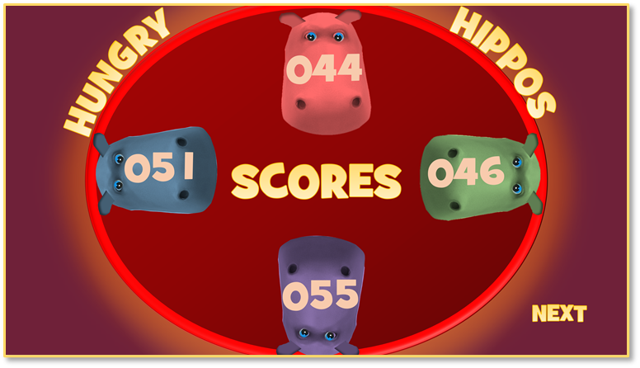
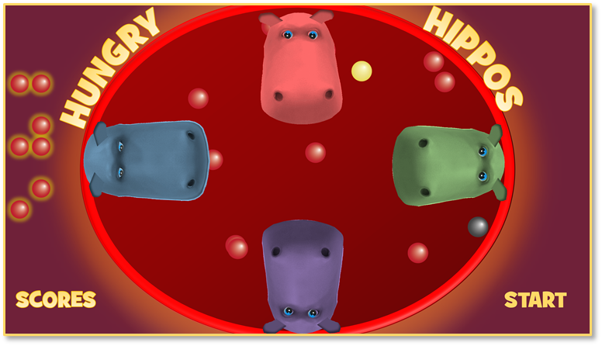
Decide on which player will have which colour, and the running order
HOW TO PLAY
2. Click on the red marbles in the ring to score a point which will appear on the left
1. First player clicks on the Start button. The red marbles will then scatter and bounce around the ring
4. Click on the numbers to add your points to your overall scoreboard – then click on the Next button for the next player’s turn
3. Add up your points after you hear the 45 second gong then click on the ‘Scores’ button
3. Add up your points after you hear the 45 second bell then click on the ‘Scores’ button
The Yellow marble is worth FIVE points.
Click on the Black marble and it’s GAME OVER
(But you do keep whatever points you have scored up until then)
PLAY
Play to an agreed time, number of rounds, or first to a points total to determine the overall winner.

Slide 3
0
9
8
7
6
5
4
3
2
1
9
8
7
6
5
4
3
2
1
0
9
8
7
6
5
4
3
2
1
0
HUNGRY
HIPPOS
0
SCORES
9
8
7
6
5
4
3
2
1
0
9
8
7
6
5
4
3
2
1
9
8
7
6
5
4
3
2
1
0
9
8
7
6
5
4
3
2
1
0
9
8
7
6
5
4
3
2
1
0
9
8
7
6
5
4
3
2
1
0
0
9
8
7
6
5
4
3
2
1
9
8
7
6
5
4
3
2
1
0
9
8
7
6
5
4
3
2
1
0
0
9
8
7
6
5
4
3
2
1
9
8
7
6
5
4
3
2
1
0
9
8
7
6
5
4
3
2
1
0
NEXT

Slide 4
HUNGRY
HIPPOS
SCORES
START

Slide 5
HUNGRY
HIPPOS
OVER
GAME
SCORES
START

