Slide 1
HOW TO PLAY
PLAY MENU
MAKE YOUR OWN TRAIL

Slide 2
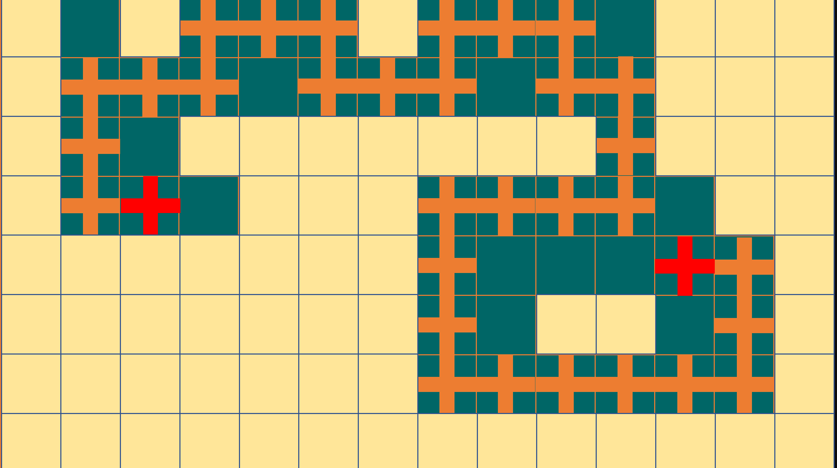
HOW TO PLAY
Once you have selected a game from the Play Menu, click on a yellow square around any point of the starting red cross (North / South / East / West – NOT diagonal).
When you reveal an orange cross, click on a yellow square at any point around that cross until you reveal an adjoining / touching orange cross. You might reveal one or more blank squares before you find it.
Continue until you make a connection to the finishing red cross.
When you finish joining the two red crosses count-up the blank squares. This is your score. You are looking for the LOWEST score you can get.
As a 2-or-more-player game, take turns to click. When a player reveals a blank square, the turn passes to the other player. The player who connects to the finishing red cross is the winner.
A simple game where all you have to do is link the two red crosses by linking a trail of orange ‘Crossroads’
As an educational game, divide students into teams. A team that answers a question correctly can choose a yellow square to remove. They continue until a blank square is revealed and the next team is asked a question. If they get it wrong, the turn passes back to the other (or another) team.
The team that connects to the finishing red cross wins.
You can start from the left or right hand red cross.
Some games have 25 connected crosses, others have 31. You will see the number in the top right corner.
PLAY MENU
MAKE YOUR OWN TRAIL

Slide 3
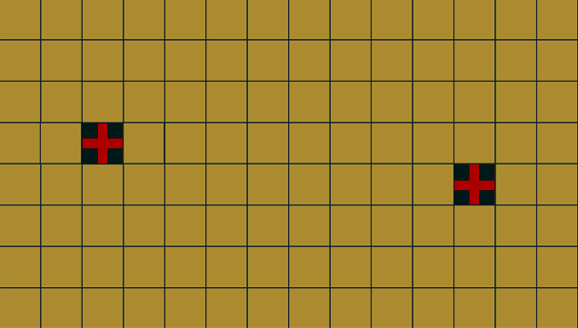
25 CROSS
GAME SELECTION
31 CROSS
GAME SELECTION
1
PLAY MENU
SELECT A SPECIFIC GAME
OR A GAME AT RANDOM
1
2
2
3
25 CROSS GAME
31 CROSS GAME
3
4
4
5
5
6
RANDOM SELECTION
(CLICK THE TEXT ABOVE)
RANDOM SELECTION
(CLICK THE TEXT ABOVE)
6
7
7
HOW TO PLAY
8
8
MAKE YOUR OWN TRAIL

Slide 4
PLAY MENU
25

Slide 5
PLAY MENU
25

Slide 6
PLAY MENU
25

Slide 7
PLAY MENU
25

Slide 8
PLAY MENU
25

Slide 9
PLAY MENU

Slide 10
PLAY MENU
25

Slide 11
PLAY MENU
25

Slide 12
PLAY MENU
31

Slide 13
PLAY MENU
31

Slide 14
PLAY MENU
31

Slide 15
PLAY MENU
31

Slide 16
PLAY MENU
31

Slide 17
PLAY MENU
31

Slide 18
PLAY MENU
31

Slide 19
PLAY MENU
31

Slide 20
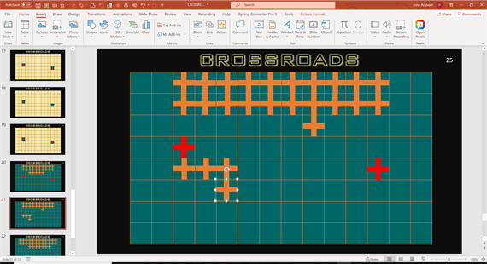
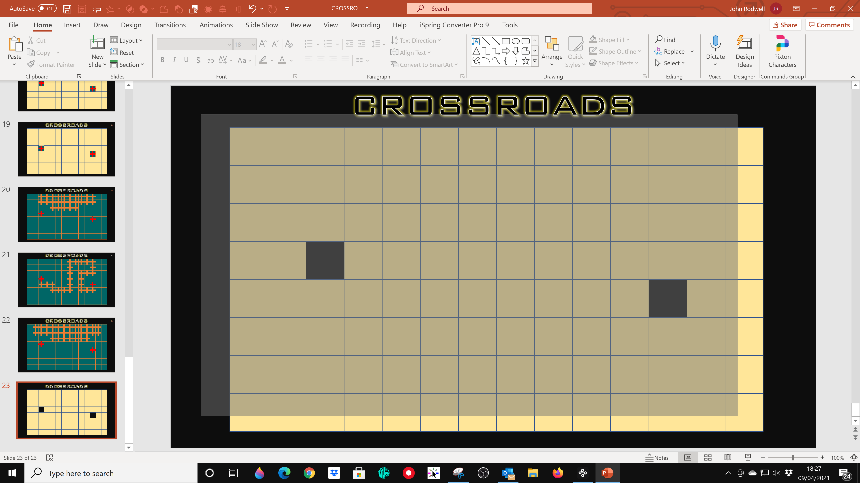
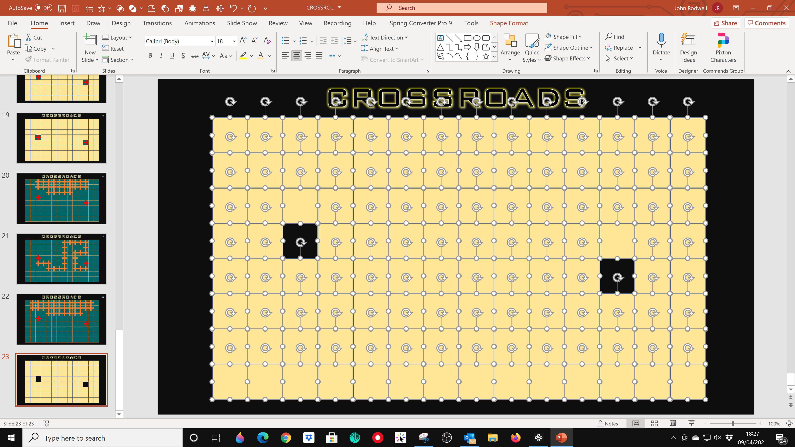
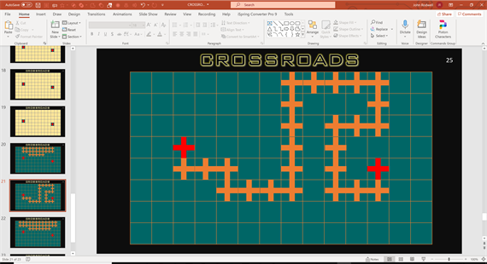
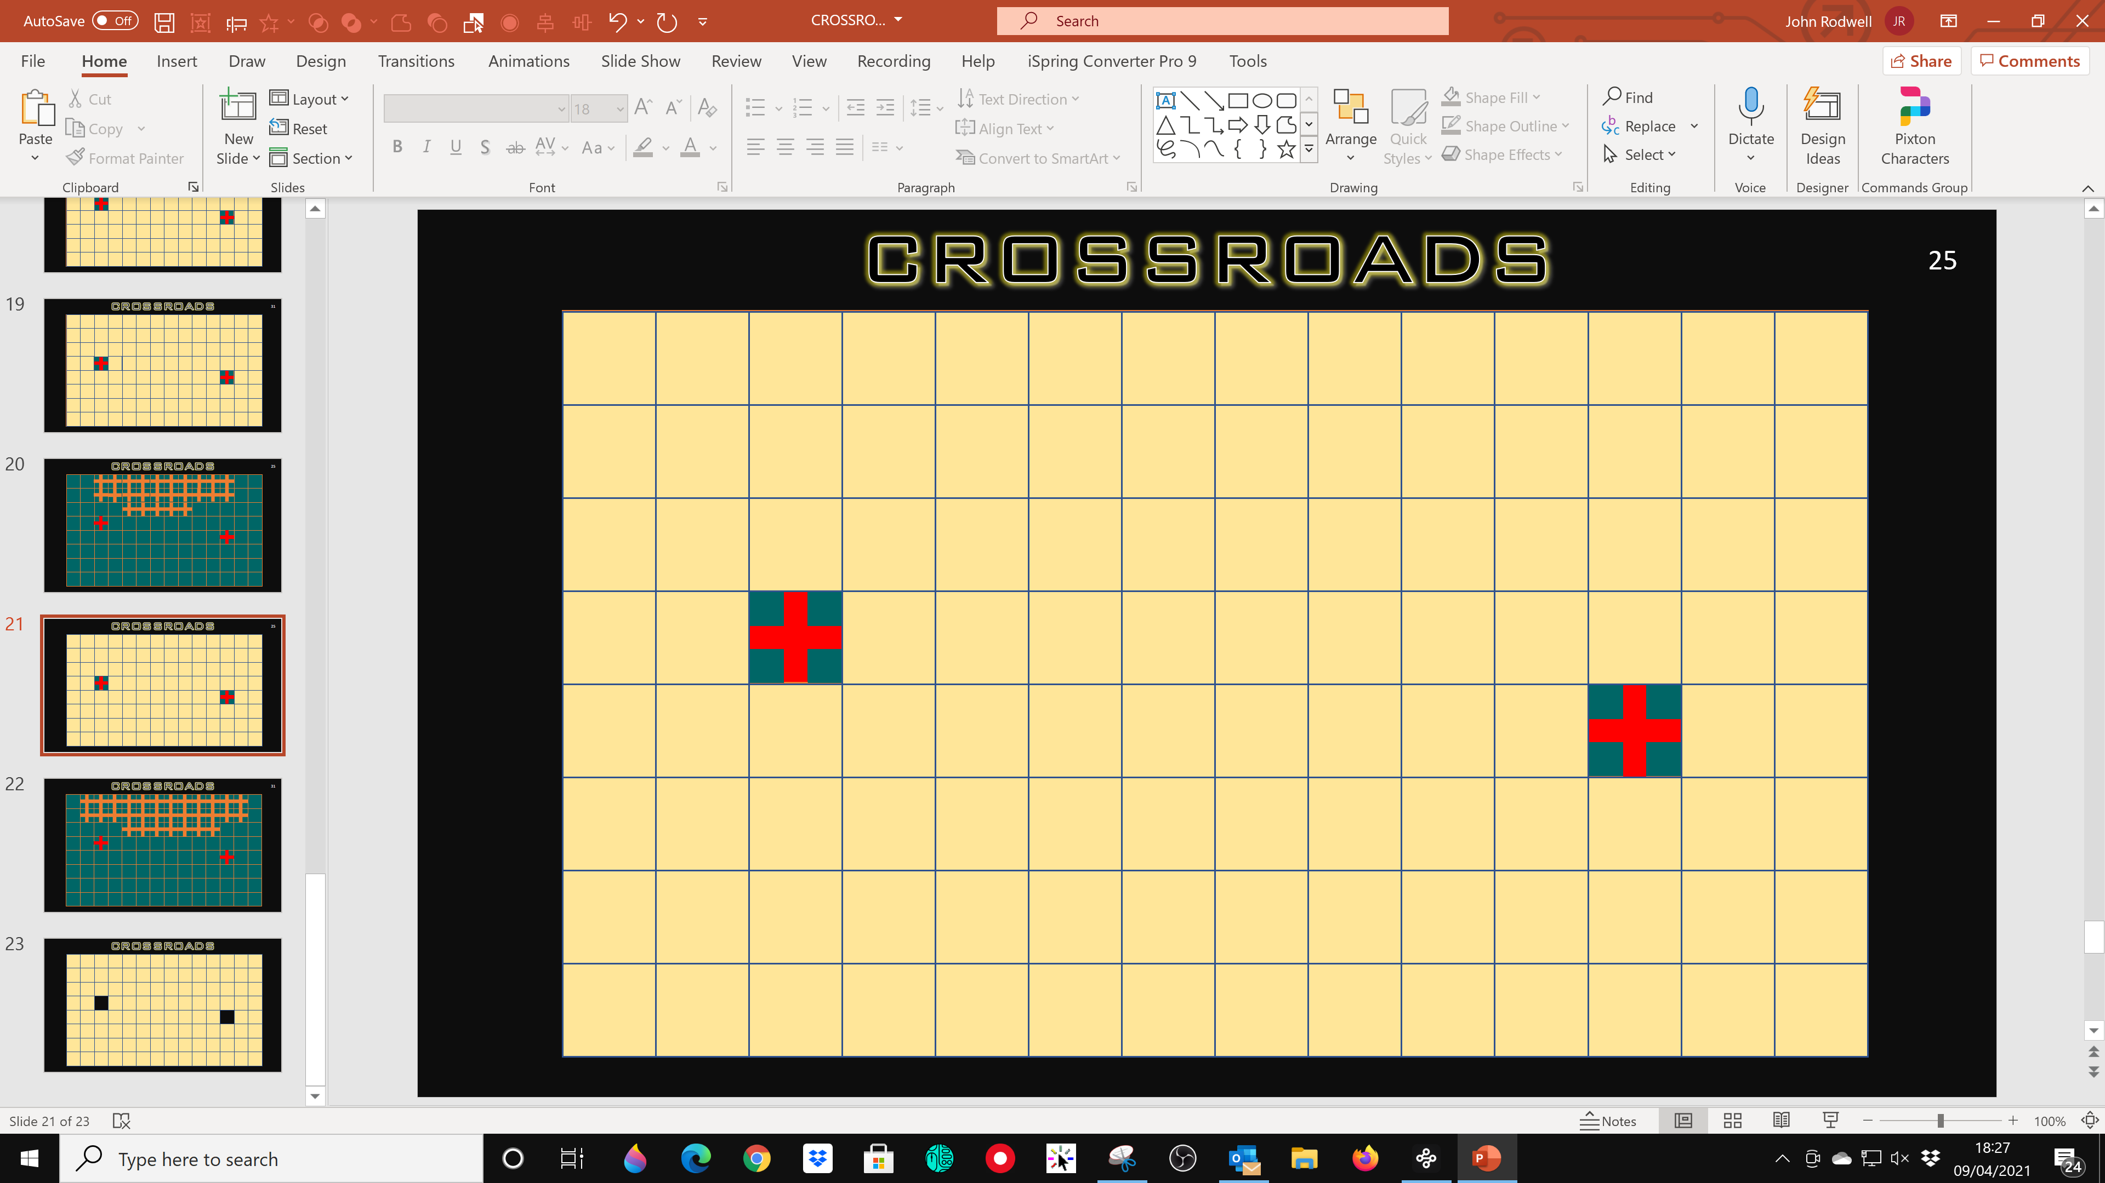
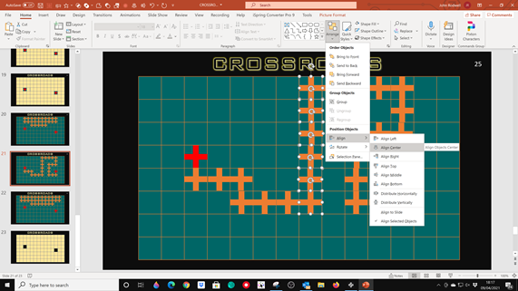
MAKE YOUR
OWN TRAIL
Open the slide with the yellow squares, hold and drag the cursor across the screen to select all of the squares
IN PRESENTATION MODE:
Duplicate one of the master templates and drag the orange crosses into a new trail to link the two red crosses
Continue until you have used all 25 or 31 crosses and completed your new trail.
Copy all the squares.
Open your new trail slide, and Paste
Your new game is ready to play
You can use the:
Home > Arrange > Align Center (and > Align Middle)
To align all the crosses if you wish
HOW TO PLAY
PLAY MENU

Slide 21
25

Slide 22
31

