Slide 1
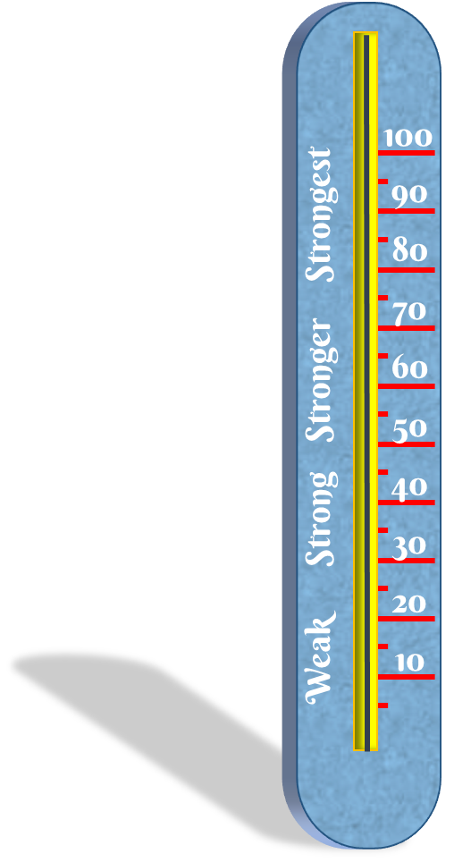
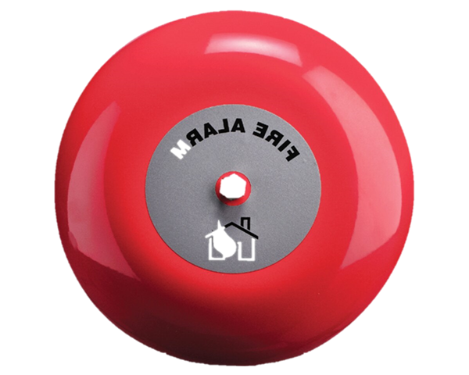
TEST YOUR STRENGTH
HOW TO
PLAY
PLAY

Slide 2
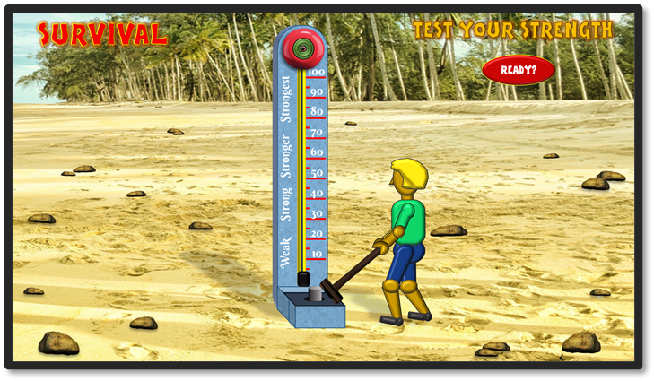
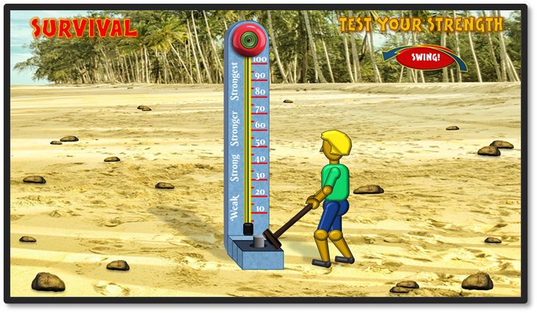
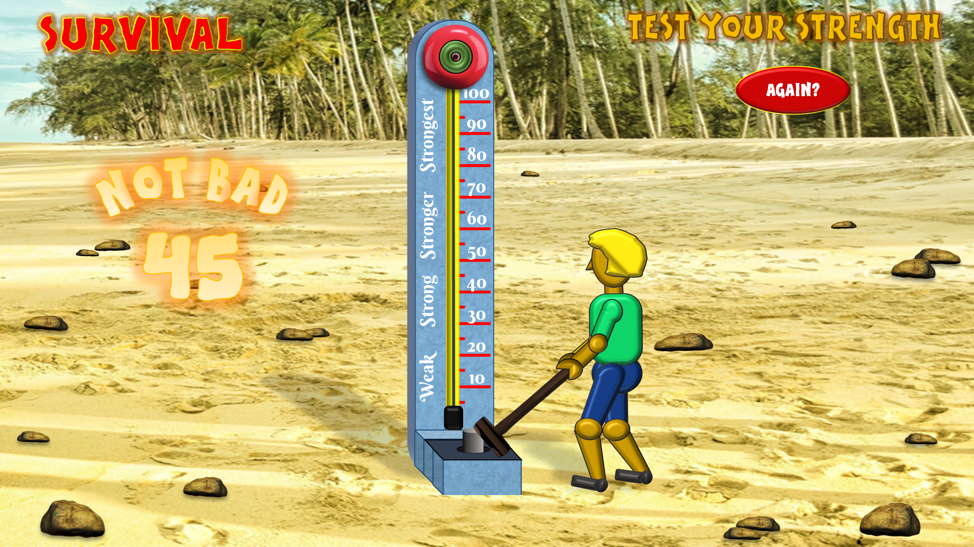
HOW TO PLAY
When ready, click on the ‘READY‘ button
When on the ‘SWING’ slide, move your cursor from one side of the screen to the other AS FAST AS YOU CAN
You will then swing the hammer to hit the plunger, raise the puck and get your score.
If you want another try, click on the ‘AGAIN’ button to return to the ‘SWING’ slide.
PLAY
Press ‘Esc’ to exit at any time

Slide 3
READY?

Slide 6
AGAIN?
BEST SCORE
100!

Slide 8
AGAIN?
GREAT SCORE!
95

Slide 10
AGAIN?
GREAT SCORE!
90

Slide 12
AGAIN?
GREAT SCORE
85

Slide 14
AGAIN?
GREAT SCORE
80

Slide 16
AGAIN?
GOOD SCORE!
75

Slide 18
AGAIN?
GOOD SCORE!
70

Slide 20
AGAIN?
GOOD SCORE!
65

Slide 22
AGAIN?
GOOD SCORE
60

Slide 24
AGAIN?
GOOD SCORE
55

Slide 26
AGAIN?
NOT BAD
50

Slide 28
AGAIN?
NOT BAD
45

Slide 30
AGAIN?
NOT BAD
40

Slide 32
AGAIN?
NOT BAD
35

Slide 34
AGAIN?
NOT GOOD
30

Slide 36
AGAIN?
NOT GOOD
25

Slide 38
AGAIN?
NOT GOOD
20

Slide 40
AGAIN?
BAD
15

Slide 42
AGAIN?
VERY BAD
10

