Slide 1
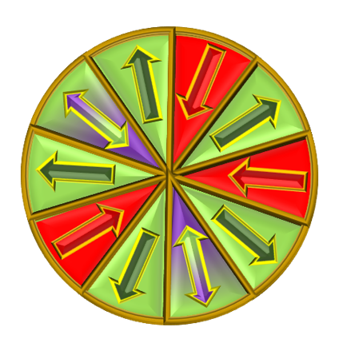
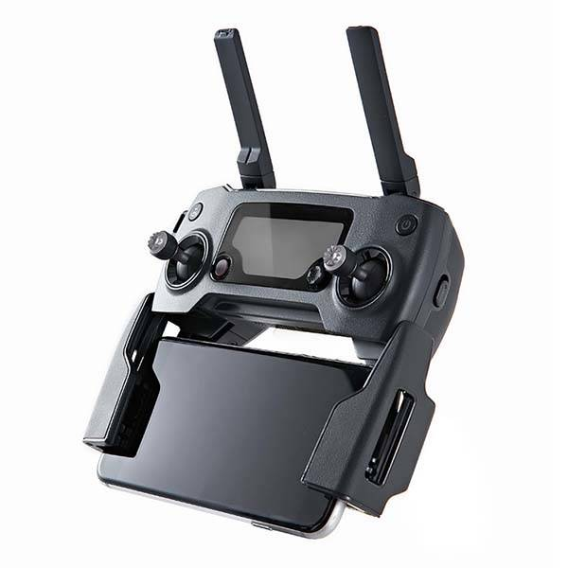
GAME OF DRONES
HOW TO PLAY
PLAY

Slide 2
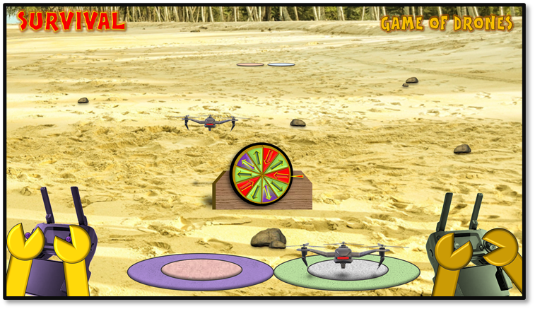
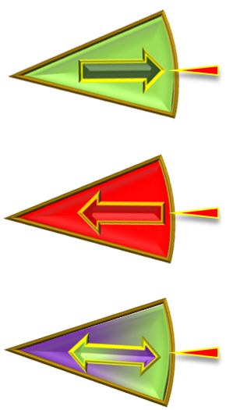
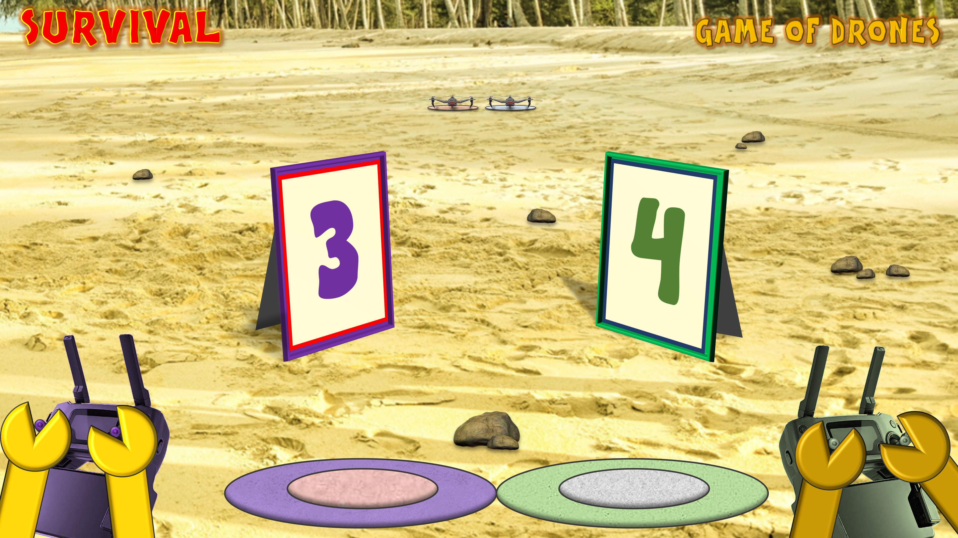
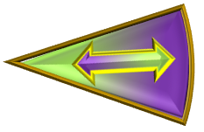
SURVIVAL
INSTRUCTIONS
GAME OF DRONES
1. Establish who will be purple and green (yellow or gold arms) and who will go first.
3. The next player takes their turn and spins the wheel and takes the action indicated.
4. Play continues in this way until a player lands their drone and wins the round.
5. Click on the rocks to go to the scoring slide then click on the relevant scoreboard to progress the scores.
6. Click on the rocks again for the next round.
2. The first player clicks on the Spinner to spin it. Then clicks again to stop it and take the action that the arrow points to:
Click on the right hand of your figure
Click on the left hand of your figure
Click on the right hand of your opponent’s figure
The first player to win 5 rounds wins the game
Dividing line: spin again
PLAY

Slide 3
SURVIVAL
GAME OF DRONES
5
3
1
4
2
0
1
2
3
4
5
0

Slide 4
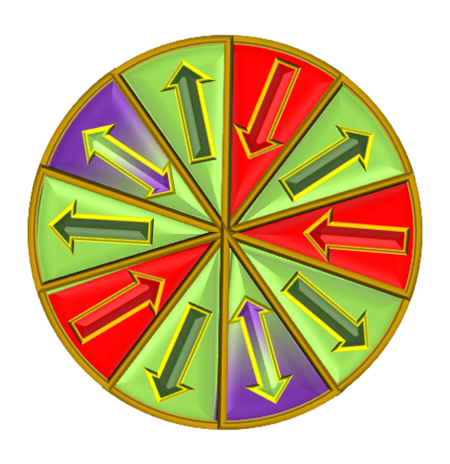
SURVIVAL
GAME OF DRONES

Slide 5
SURVIVAL
GAME OF DRONES

Slide 6
SURVIVAL
GAME OF DRONES

Slide 7
SURVIVAL
GAME OF DRONES

Slide 8
SURVIVAL
GAME OF DRONES

Slide 9
SURVIVAL
GAME OF DRONES

Slide 10
SURVIVAL
GAME OF DRONES

Slide 11
SURVIVAL
GAME OF DRONES

Slide 12
SURVIVAL
GAME OF DRONES

Slide 13
SURVIVAL
GAME OF DRONES

