Slide 1
MOMENT OF TRUTH
The ‘Plumpy Brothers’ is a stage act that requires that all the brothers look exactly the same and weigh exactly the same.
But there is a problem. One of the brothers has either lost 2 kilos in weight, or gained 2 kilos in weight.
At the moment, no-one knows which brother it is, or whether he has gained or lost the 2 kilos.
To resolve this, you are asked to use the only available balance scales and identify the heavier or lighter brother, and if he has gained or lost the 2 kilos. You have just THREE weighing opportunities to achieve this before you get to the
Click on the Instructions link below for more details of what to do.
MOMENT OF TRUTH
Play
Instructions

Slide 2
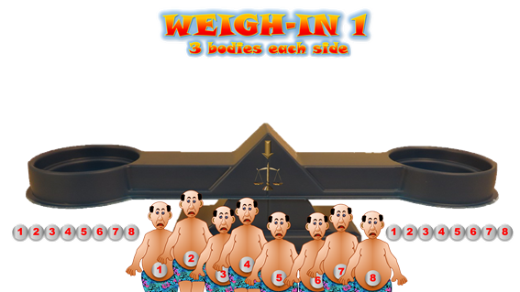
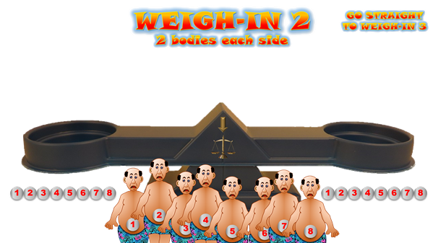
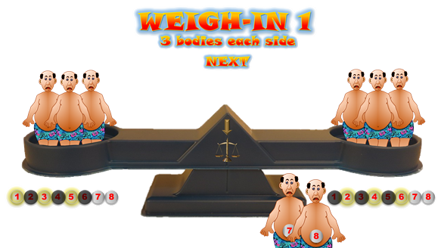
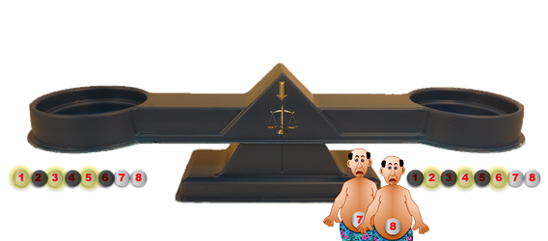
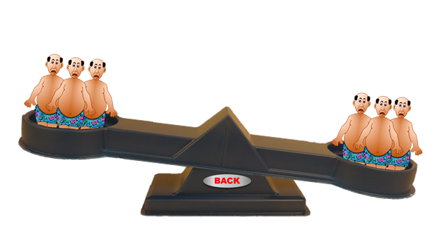
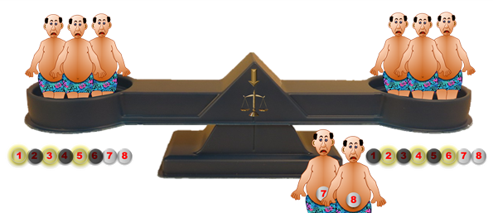
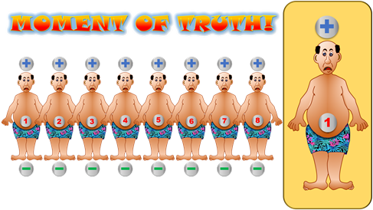
Play
7. If you think you are close to the answer after Weigh-in 1, you can go straight to Weigh-in 3 if you wish.
8. From Weigh-in 3 you will go to the
9. Check your answer here by clicking above or below the figure you think has gained (+) or lost (-) the weight.
6. Repeat the process for Weigh-in 2 (choose 2 bodies), then Weigh-in 3 (Choose 1 body).
MOMENT OF TRUTH
1. Click 3 times on each side to select the bodies to be weighed (the same number on the opposite side will be blanked out).
2. When selected, click on the down arrow to load the scales with the brothers you have chosen.
5. Consider who you want to put on the scales next, then click on NEXT.
10. If you are wrong, a link appears for you to try again if you want.
3. When the scales are loaded, click on the
picture of the scales.
4. Click on the scales picture again and the big scales will tip one way or the other, or wobble, and stay balanced.
Now click on ‘Back’.
11. If you are right, your choice will appear and you can choose the next game or exit.

Slide 3
THERE ARE THREE DIFFERENT GAMES TO PLAY
CLICK ON THE ONE YOU WANT
GAME 1
GAME 3
GAME 2

Slide 4
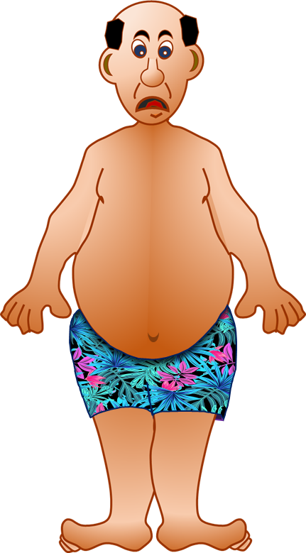
GAME 1
WEIGH-IN 1
3 bodies each side
NEXT
1
2
3
4
5
6
7
8
1
2
3
4
5
6
7
8
1
2
4
3
5
7
6
8

Slide 5
GAME 1
WEIGH-IN 2
GO STRAIGHT
TO WEIGH-IN 3
2 bodies each side
NEXT
1
2
3
4
5
6
7
8
1
2
3
4
5
6
7
8
2
1
4
7
3
5
8
6

Slide 6
GAME 1
WEIGH-IN 3
1 body each side
MOMENT OF TRUTH
1
2
3
4
5
6
7
8
1
2
3
4
5
6
7
8
2
1
4
7
3
5
8
6

Slide 7
GAME 1
BACK

Slide 8
GAME 1
BACK

Slide 9
GAME 1
BACK

Slide 10
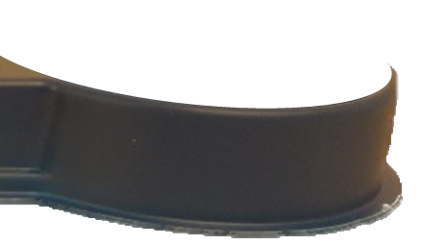
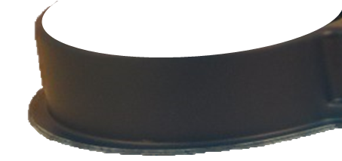
GAME 1
BACK

Slide 11
GAME 1
BACK

Slide 12
GAME 1
BACK

Slide 13
GAME 1
BACK

Slide 14
GAME 1
BACK

Slide 15
GAME 1
BACK

Slide 16
GAME 1
+
MOMENT OF TRUTH!
1
2
3
4
5
6
7
8
5
WELL DONE!
CLICK HERE TO RETURN TO GAME CHOICE
EXIT
TRY AGAIN?

Slide 17
GAME 2
WEIGH-IN 1
3 bodies each side
NEXT
1
2
3
4
5
6
7
8
1
2
3
4
5
6
7
8
1
2
4
3
5
7
6
8

Slide 18
GAME 2
WEIGH-IN 2
GO STRAIGHT
TO WEIGH-IN 3
2 bodies each side
NEXT
1
2
3
4
5
6
7
8
1
2
3
4
5
6
7
8
2
1
4
7
3
5
8
6

Slide 19
GAME 2
WEIGH-IN 3
1 body each side
MOMENT OF TRUTH
1
2
3
4
5
6
7
8
1
2
3
4
5
6
7
8
2
1
4
7
3
5
8
6

Slide 20
GAME 2
BACK

Slide 21
GAME 2
BACK

Slide 22
GAME 2
BACK

Slide 23
GAME 2
BACK

Slide 24
GAME 2
BACK

Slide 25
GAME 2
BACK

Slide 26
GAME 2
BACK

Slide 27
GAME 2
BACK

Slide 28
GAME 2
BACK

Slide 29
GAME 2
MOMENT OF TRUTH!
2
1
2
3
4
5
6
7
8
WELL DONE!
CLICK HERE TO RETURN TO GAME CHOICE
EXIT
TRY AGAIN?

Slide 30
GAME 3
WEIGH-IN 1
3 bodies each side
NEXT
1
2
3
4
5
6
7
8
1
2
3
4
5
6
7
8
1
2
4
3
5
7
6
8

Slide 31
GAME 3
WEIGH-IN 2
GO STRAIGHT
TO WEIGH-IN 3
2 bodies each side
NEXT
1
2
3
4
5
6
7
8
1
2
3
4
5
6
7
8
2
1
4
7
3
5
8
6

Slide 32
GAME 3
WEIGH-IN 3
1 body each side
MOMENT OF TRUTH
1
2
3
4
5
6
7
8
1
2
3
4
5
6
7
8
2
1
4
7
3
5
8
6

Slide 33
GAME 3
BACK

Slide 34
GAME 3
BACK

Slide 35
GAME 3
BACK

Slide 36
GAME 3
BACK

Slide 37
GAME 3
BACK

Slide 38
GAME 3
BACK

Slide 39
GAME 3
BACK

Slide 40
GAME 3
BACK

Slide 41
GAME 3
BACK

Slide 42
GAME 3
MOMENT OF TRUTH!
7
1
2
3
4
5
6
7
8
WELL DONE!
CLICK HERE TO RETURN TO GAME CHOICE
TRY AGAIN?
EXIT

