Slide 1
TORPEDO
PLAY

Slide 2
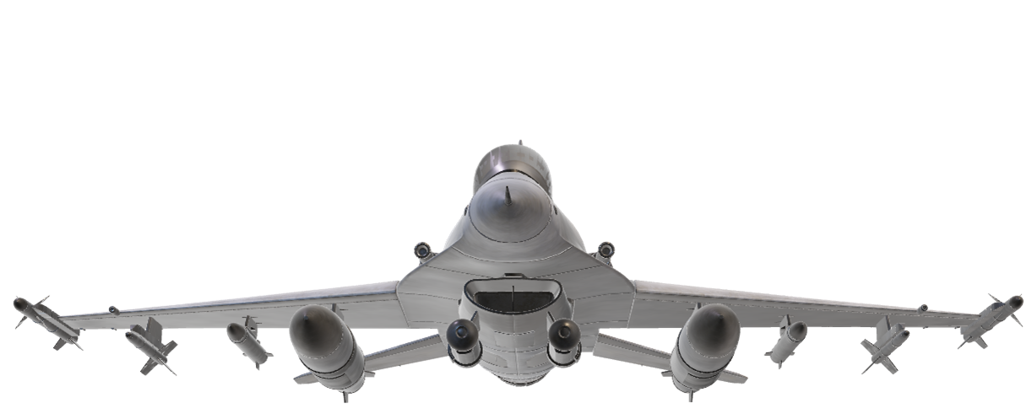
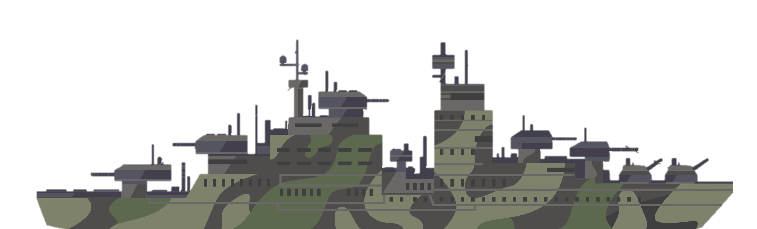
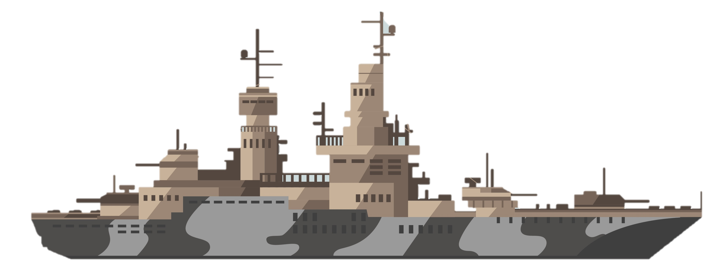
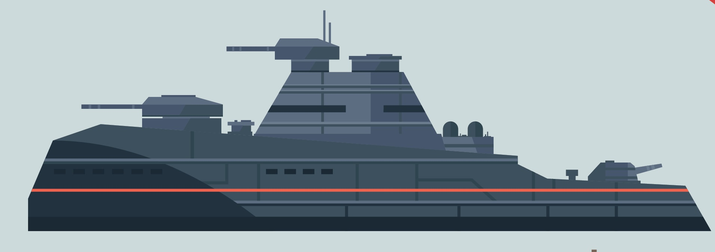
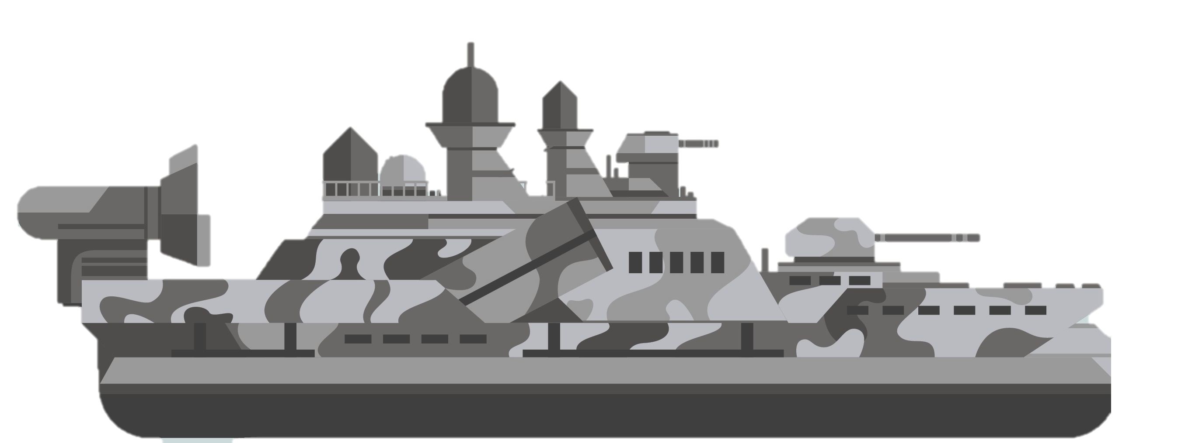

Slide 3
Q1
A1
A2
A3
A4

Slide 4
Q2
A1
A2
A3
A4

Slide 5
Q3
A1
A2
A3
A4

Slide 6
Q4
A1
A2
A3
A4

Slide 7
Q5
A1
A2
A3
A4

Slide 8
Q6
A1
A2
A3
A4

Slide 9
Q7
A1
A2
A3
A4

Slide 10
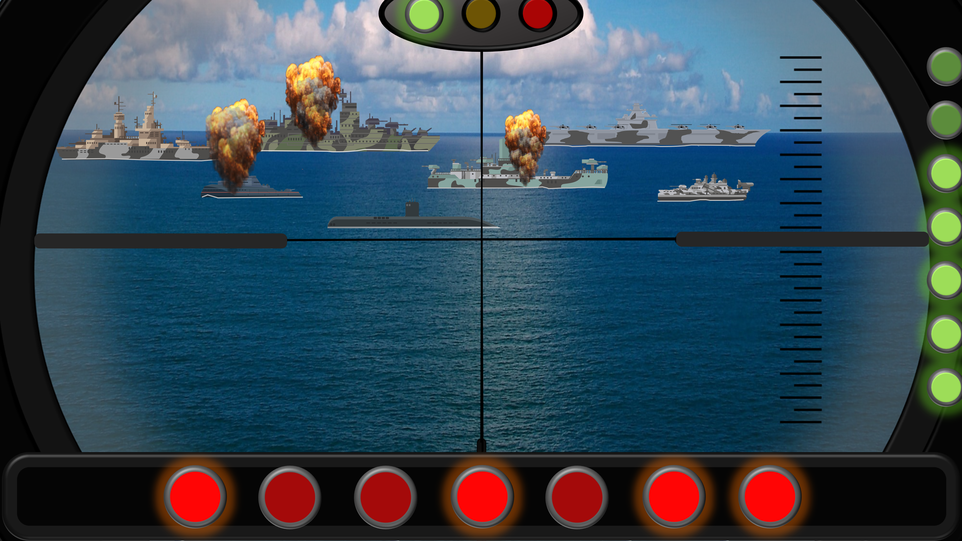
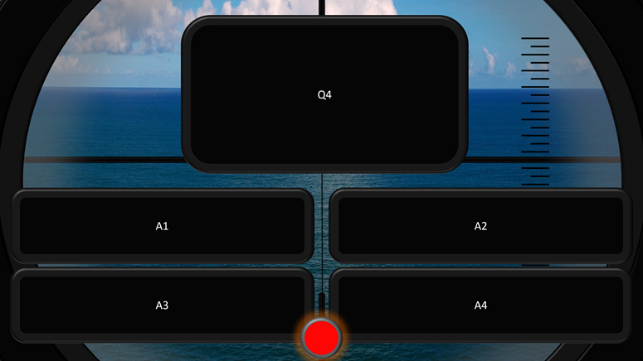
TORPEDO
1. Click on a green light to go to a question slide.
2. Question slide.
A question with 4 possible answers. Click on the chosen answer.
4. If the answer is correct, click on a red light to fire a torpedo (in any order).
3. Click on the red button to go back to the main slide.
5. If the answer was incorrect, click firstly on the Amber light.
You can change the number of answer options and rearrange the boxes as you wish
6. If a second answer is incorrect, click on the Red light (Game Over).

