Slide 1
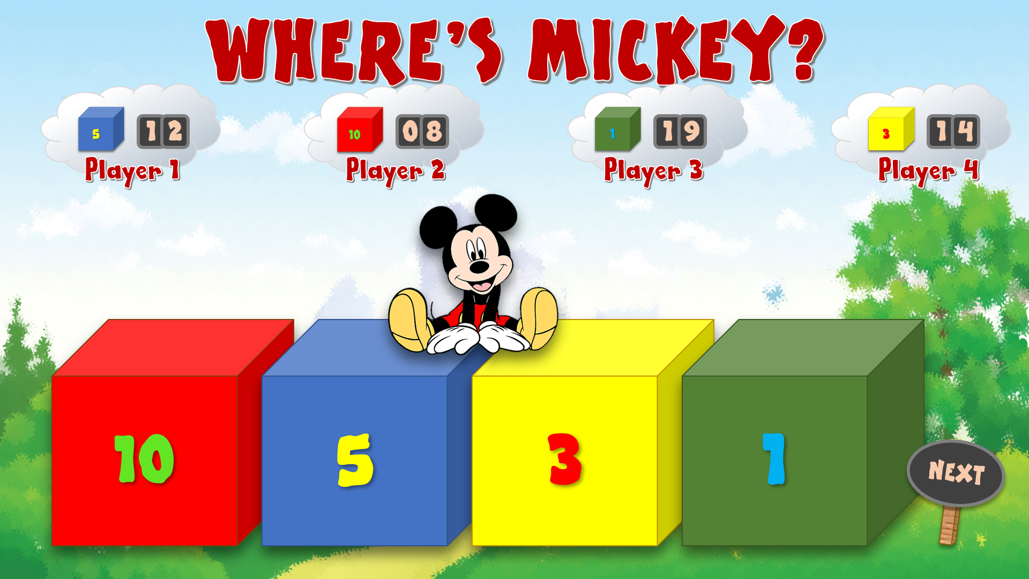
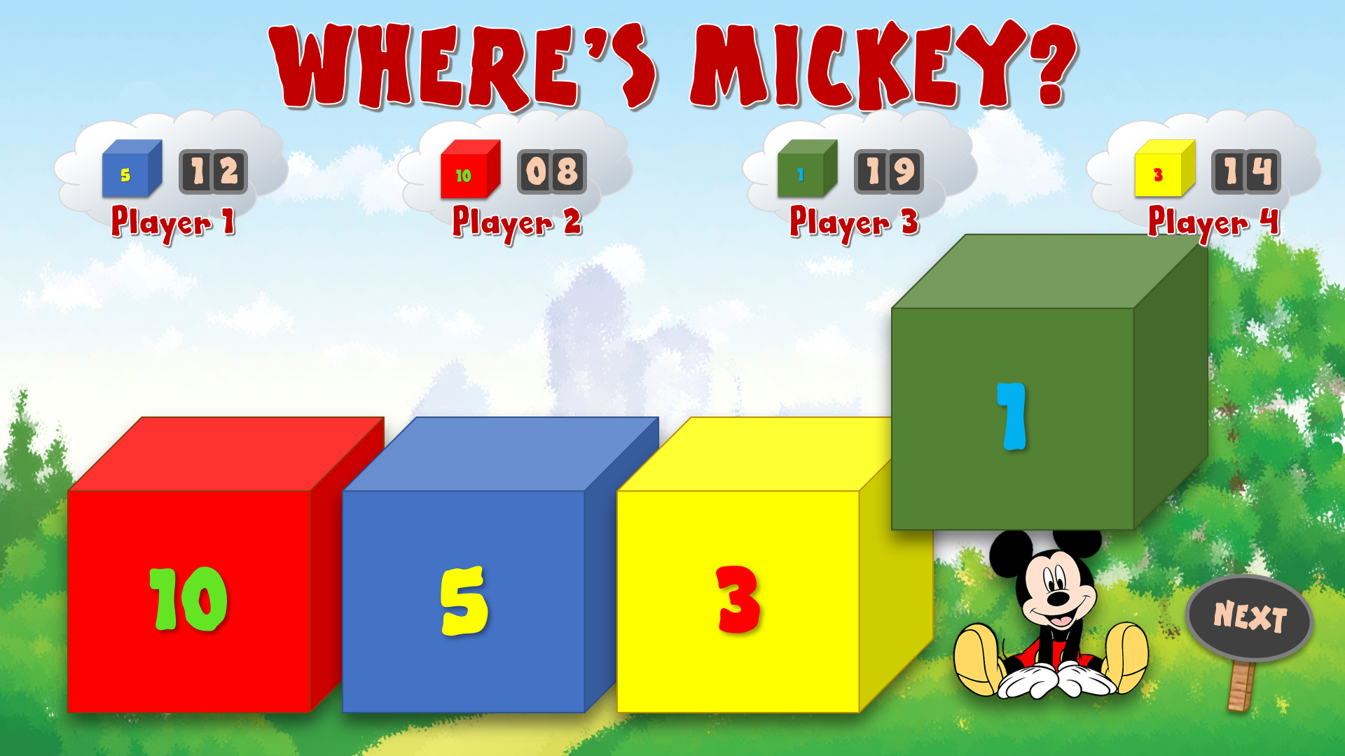
WHERE’S MICKEY?
A game for up to 4 players. How to play:
Decide on the winning overall score for this game (e.g. 20).
Each player then clicks on the small cube on their cloud to indicate which cube they think Mickey is going to be found under (and the number of points they will score if they are correct).
Click on the Mickey sitting on top of the big cubes. He will fly off and hide in one of the cubes.
4. Click on each cube to see if Mickey is there.
5. Any players who have chosen the correct cube can click the numbers on their scoreboards to add the points shown on that cube.
6. Then click the ‘NEXT’ sign for the next game.
7. Continue play until one player achieves the winning overall score.
8. The remaining players can continue for 2nd, 3rd, 4th positions if desired.
PLAY

Slide 2
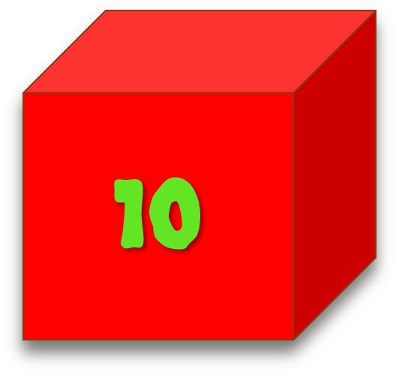
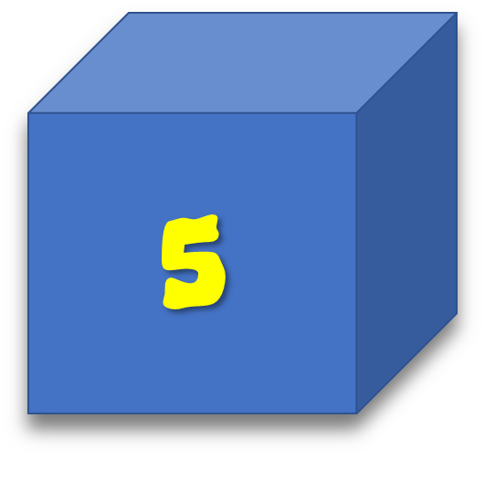
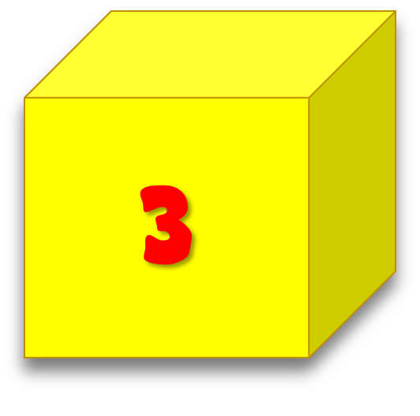
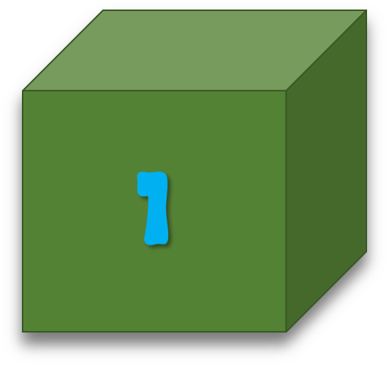
WHERE’S MICKEY?
9
8
7
6
5
4
3
2
1
0
9
8
7
6
5
4
3
2
1
0
9
8
7
6
5
4
3
2
1
0
9
8
7
6
5
4
3
2
1
0
9
8
7
6
5
4
3
2
1
0
9
8
7
6
5
4
3
2
1
0
9
8
7
6
5
4
3
2
1
0
9
8
7
6
5
4
3
2
1
0
Player 1
Player 2
Player 3
Player 4
10
5
3
1
NEXT

