Slide 1
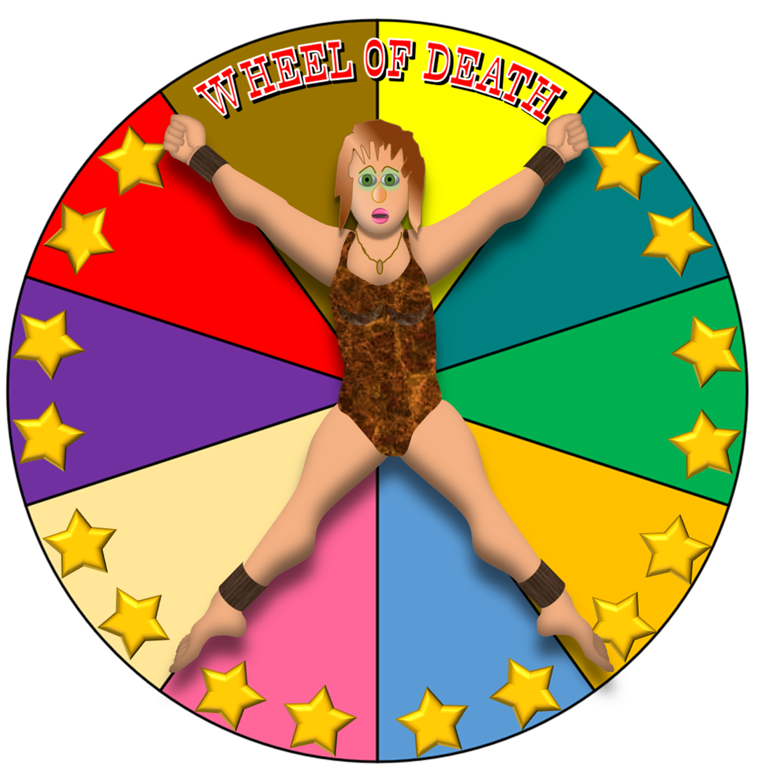
HOW TO PLAY
THROW YOUR KNIVES TO HIT
THE 10 COLOURED SEGMENTS
OF THE BOARD BY CLICKING ON
EACH OF THEM AS IT SPINS
LEVEL 1
LEVEL 2
MAKE SURE YOU AVOID
HITTING YOUR GLAMOROUS
ASSISTANT THOUGH!
THE WHEEL WILL ROTATE
MORE QUICKLY AT EACH
LEVEL
LEVEL 3
LEVEL 4
CLICK THIS BUTTON
TO START THE SPIN
– AND STOP IT
CLICK THIS BUTTON
TO REMOVE THE KNIVES

Slide 2
LEVEL 1
NEXT LEVEL
HOME
SPIN
CLEAR

Slide 3
LEVEL 2
NEXT LEVEL
HOME
SPIN
CLEAR

Slide 4
LEVEL 3
NEXT LEVEL
HOME
(AT THIS SPEED IT MAY
TAKE SEVERAL CLCKS TO
TRIGGER A THROW)
SPIN
CLEAR

Slide 5
LEVEL 4
HOME
(AT THIS SPEED IT MAY
TAKE SEVERAL CLCKS TO
TRIGGER A THROW)
SPIN
CLEAR

