Slide 1
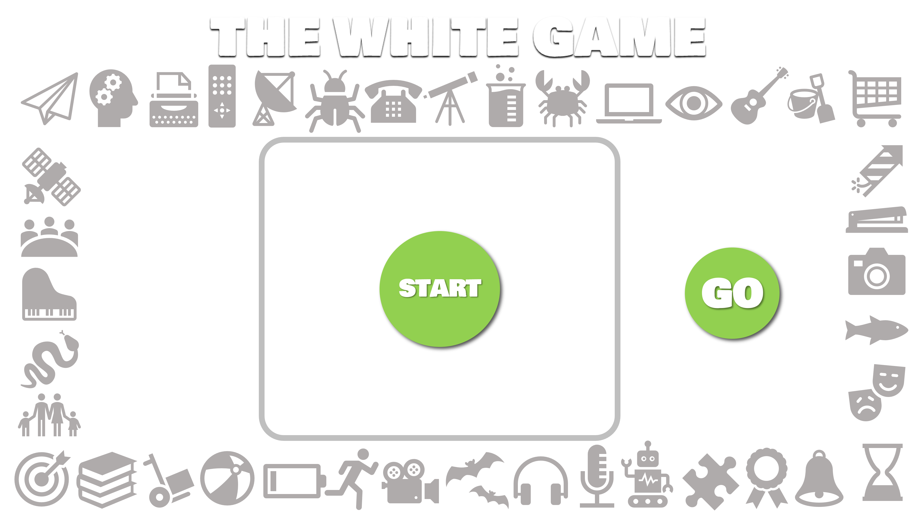
PLAY
HOW TO PLAY
3. CLICK ON ‘GO’ AND SEARCH WITH YOUR CURSOR AROUND THE WHITE SCREEN
4. AS YOU SEARCH, TRY TO REMEMBER WHERE YOU SEE OTHER ICONS APPEARING
Tip: search around at the start to see where the icons are located
2. THE ICON TO BE FOUND WILL APPEAR
1. CLICK HERE TO START
5. WHEN YOU FIND YOUR TARGET ICON, CLICK ON IT TO RETURN TO THE MAIN SCREEN
7. THE NEXT ICON TO BE FOUND WILL APPEAR. CLICK ON ‘GO’ AND SEARCH FOR IT. REPEAT UNTIL YOU HAVE FOUND EVERY ICON
6. CLICK ON THE BORDER ICON TO REDUCE ITS SIZE AND SHOW THAT IT HAS BEEN FOUND

Slide 2
COMPLETE!
START
GO

