Slide 1
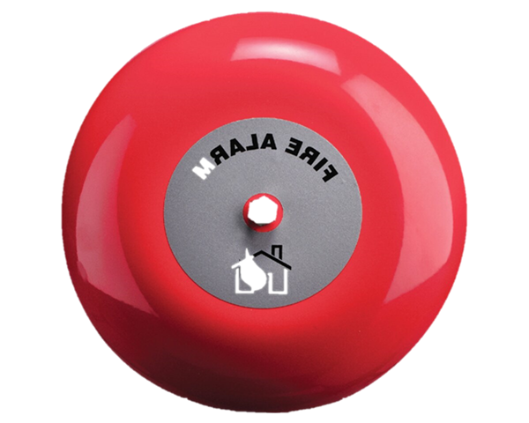
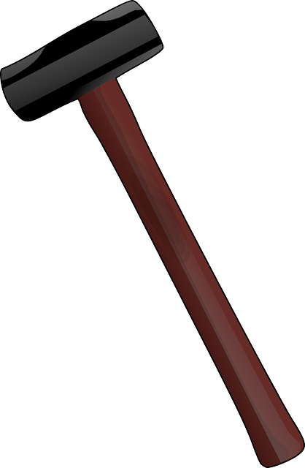
TEST
YOUR
STRENGTH
100
100
90
90
TEST YOUR STRENGTH
80
80
70
70
60
60
50
50
40
40
30
30
20
20
10
10
PLAY

Slide 2
SURVIVAL
TEST YOUR
STRENGTH
TEST
YOUR
STRENGTH
TEST
YOUR
STRENGTH
100
100
90
90
80
80
70
70
60
60
50
50
40
40
5
4
3
2
1
0
0
5
3
1
4
2
30
30
20
20
10
10

Slide 3
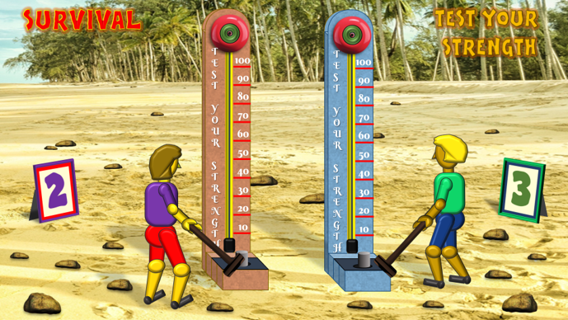
TEST YOUR STRENGTH
INSTRUCTIONS
1. Establish the purple and green teams and who goes first
2. Ask a question to the first team.
If the answer is correct, click on the large rock in the relevant bottom corner of the slide.
If the answer is incorrect, click on one of the five small rocks on the relevant side around the figure…
then ask the same question to the other team.
The first team to score 5 clear points will be the winners.
In the event of a draw, click on the Survivor title to reset the game and play a ‘sudden death’ round.
When there is a sudden death winner, click on relevant centre rock for the team’s music and celebrations.
You can also click on the Survivor title to start a new round.
The scoreboards will change automatically when the answer is correct and the bell is rung.
The victory celebrations will also be automatic.

