Slide 1
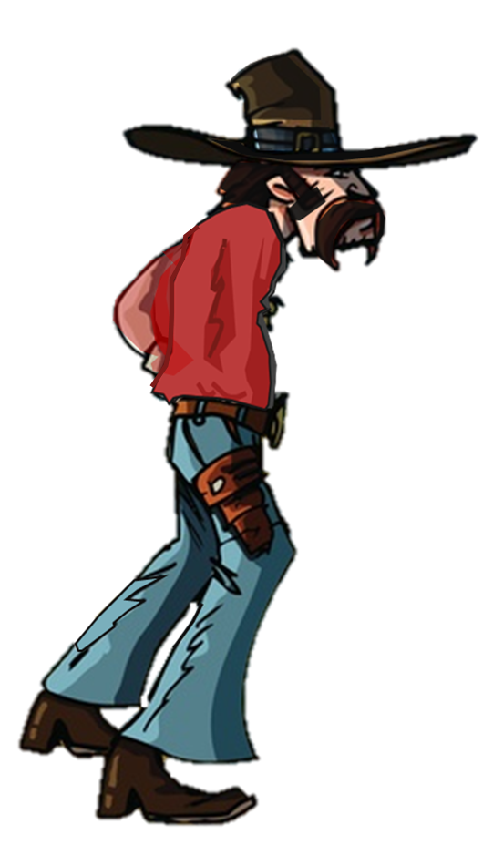
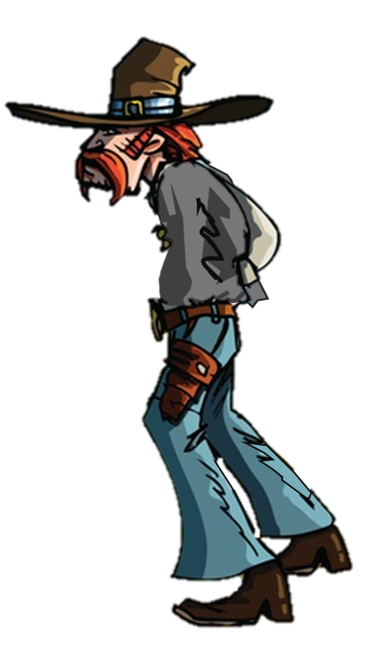
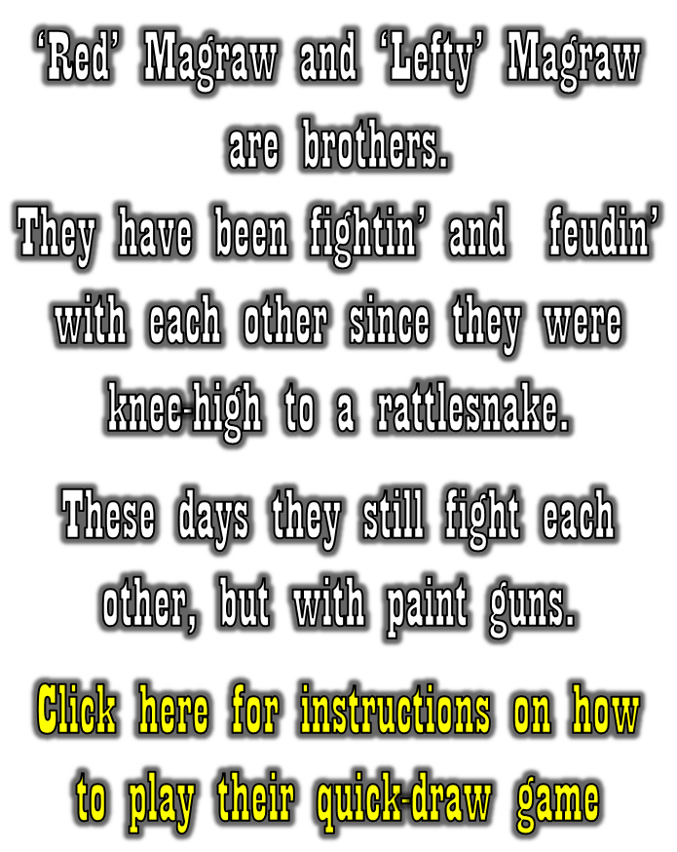
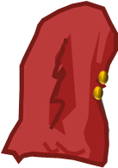
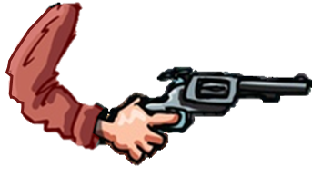
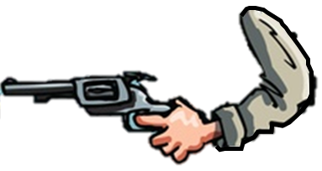
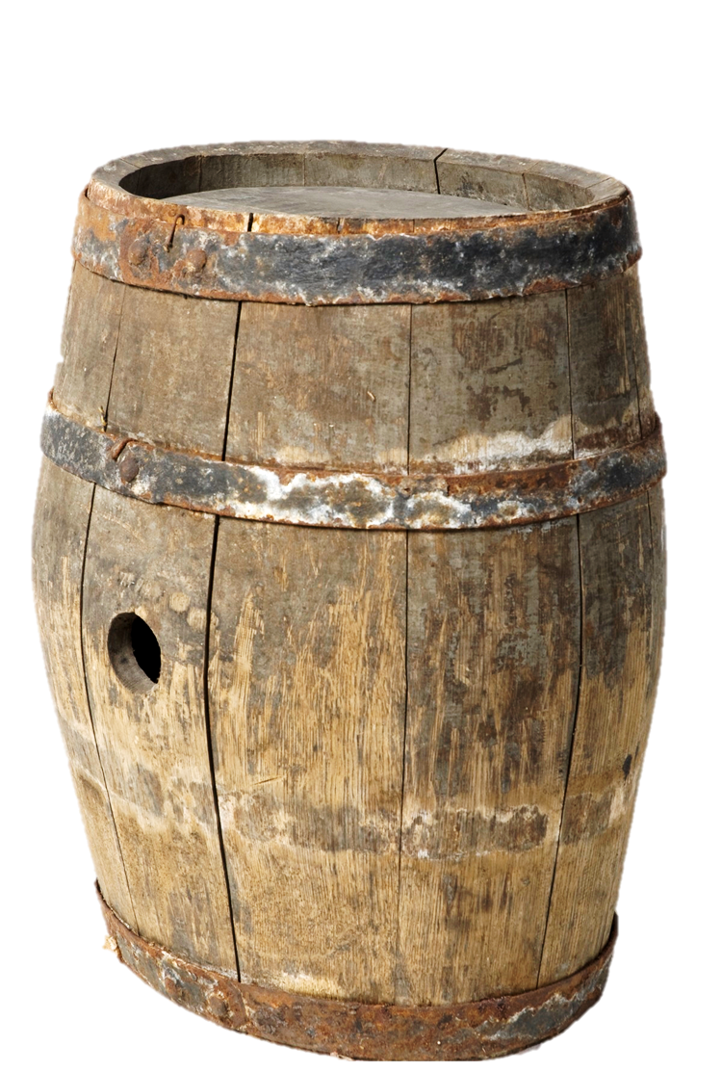
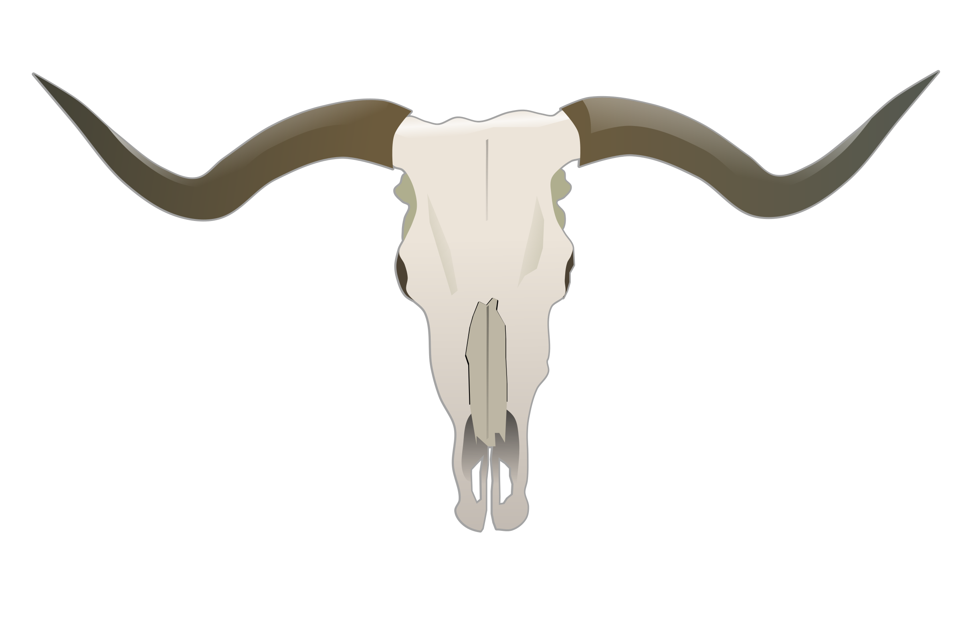

Slide 2
1. Click on the white steer skull
It will turn yellow after 2-3 seconds. Make sure your cursor is ready on your holster
2. When it turns green the shoot-out’s on!
Then…when the red skull appears click on your gun holster to shoot
(The red skull will not always appear at the same time)
If you are the fastest, you will shoot your paint ball and win the round.
Click on the red skull above to get started.
On the following screens you can click on the red skull in the top right corner for another shootout or try again with the same white skull if you lose
This will appear if Red wins
This will appear if Lefty wins (you)

