Slide 1
HOW TO
PLAY
HOW TO
SCORE
PLAY

Slide 2
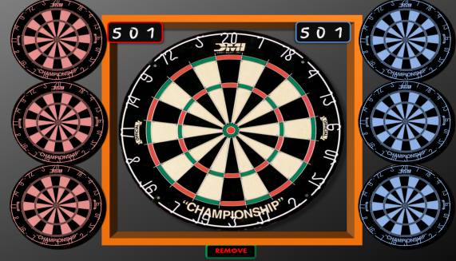
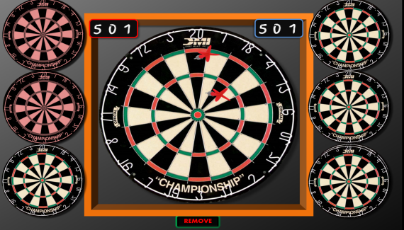
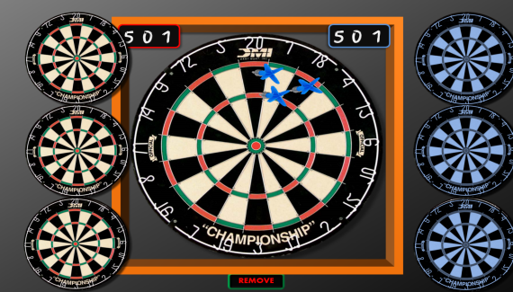
HOW TO PLAY
To start, each player picks a colour (red or blue). Wait until the red and blue boards are circling smoothly, then click on the REMOVE button to reveal the circling target boards.
Bear in mind that the the target boards are moving, and some parts are small (trebles / doubles / bull etc).
It may therefore take several clicks on the target board before one registers as a throw.
The game has a lot of animations so may take a moment or two to load
Each player then has three throws at the central board by clicking on each of the three circling target boards at the point they want the dart to land (treble 20 / double 16 etc).
As each dart is ‘thrown’ the target board will be covered. After the third throw the score will need to be added up and the total subtracted from the scoreboard (if playing 501 or 301).
Click on the REMOVE button to remove the darts and the covers for the next player to throw.
HOW TO
PLAY
PLAY

Slide 3
HOW TO SCORE
When clicked, each digit of the scoreboard will reduce the number by 1.
The default scoreboard is for a game of 501 (straight in / double to finish).
You can click on the ‘5’ twice for a game of 301 (double in / double to finish)
You can use mental arithmetic, pen & paper or a calculator to keep score, or use the method below.
The scoreboard consists of three digits: Hundreds / Tens / Units. So for example:
If you have a score of 285 and you throw a 68: click 8 times on the Units. If the Units go past zero, click once on the Tens. Then click 6 times on the Tens = 217
If you then have a score of 140: leave the units, click 4 times on the Tens. If the Tens go past zero, click once on the Hundreds, then click 1 more time on the Hundreds = 77
As the dart game plays like a ‘real’ game of darts, you can play any game you like but may have to keep scores manually for yourselves.
Click on these numbers to progress the score when a game has been won
(First to 5 is overall winner)
HOW TO
PLAY
PLAY

Slide 4
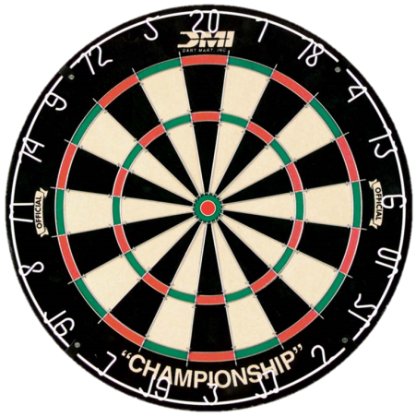
home
5
4
3
2
1
0
0
9
8
7
6
5
4
3
2
1
0
9
8
7
6
5
4
3
2
5
1
4
3
2
1
0
0
9
8
7
6
5
4
3
2
1
0
9
8
7
6
5
4
3
2
1
5
4
3
2
1
0
5
4
3
2
1
0
REMOVE

