Slide 1
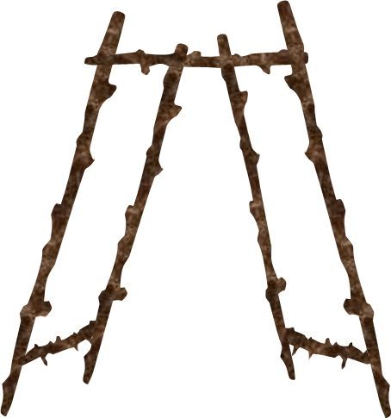
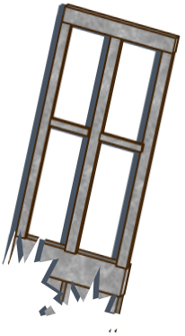
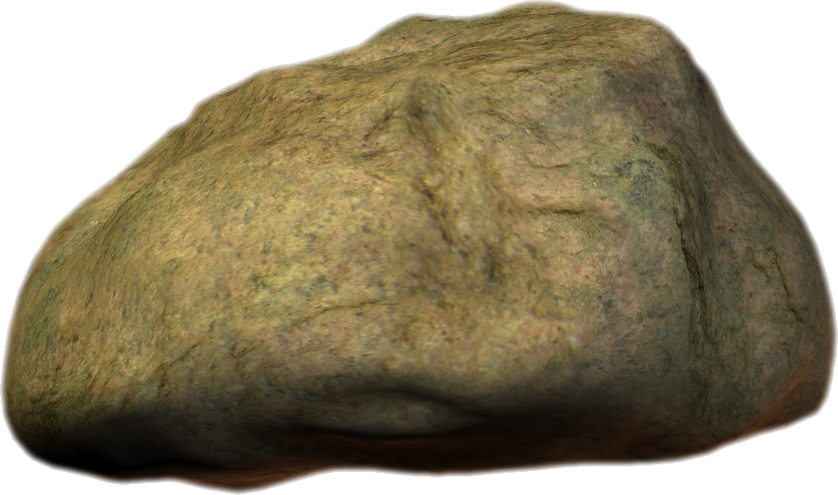
GATECRASH
PLAY

Slide 2
SURVIVAL
GATECRASH

Slide 3
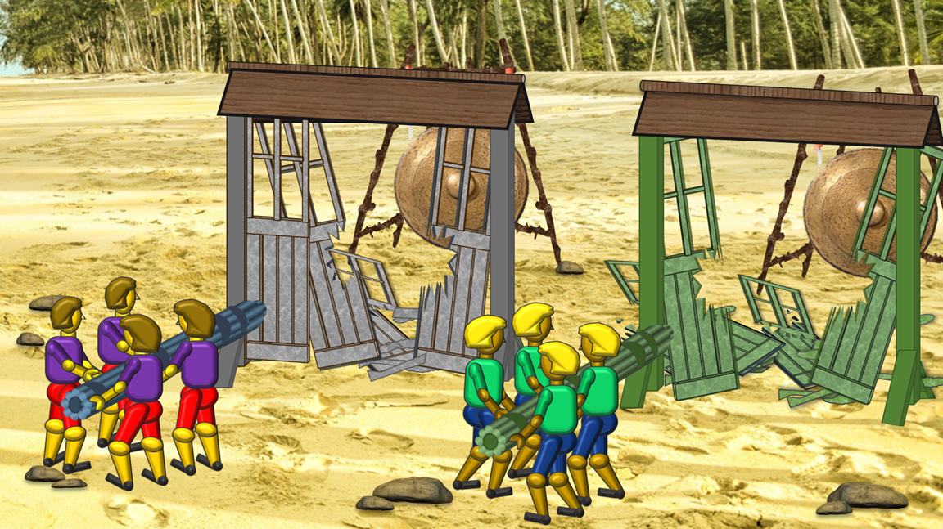
INSTRUCTIONS
GATECRASH
1. Establish purple and green teams and who goes first
2b. If the answer is incorrect, click on the RIGHT side of the rocks then ask the same question to the next team.
2. Ask a question to the first team
2a. If the answer is correct, click on the LEFT side of the rocks
3. The winning team will be the first to break down all the sections of their gate and hit the gong. (Requires five questions to be answered correctly.

