Slide 1
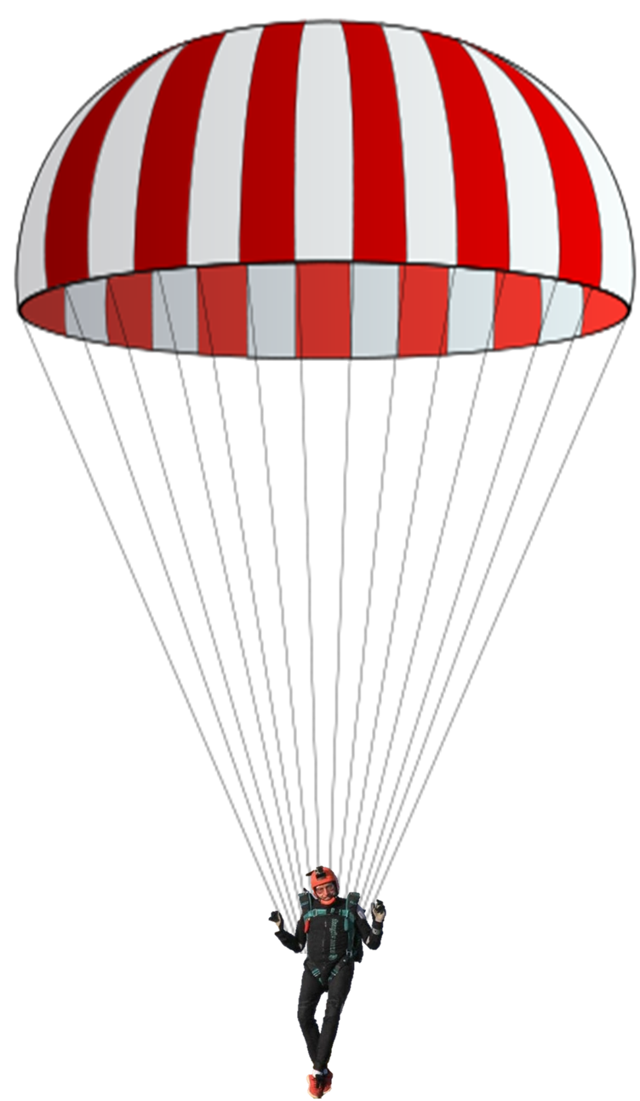
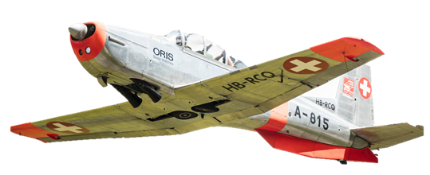
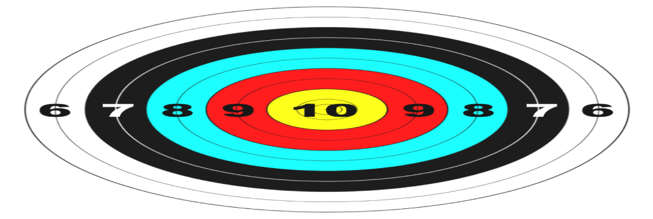
PARAJUMP
CHECK THE WIND SPEED AND DIRECTION
BY THE MOVEMENT OF THE CLOUDS
THEN CLICK ON THE AIRPLANE WHEN
YOU WANT YOUR PARACHUTIST TO JUMP
SCORE THE POINTS THAT THE
PARACHUTIST LANDS ON,
THEN CLICK ON THE BUTTON TO
TAKE YOU TO THE SCORECARD
WHERE YOU MARK YOUR SCORE
AND GO TO THE NEXT JUMP
START

Slide 2
JUMP 1

Slide 3
JUMP 2

Slide 4
JUMP 3

Slide 5
JUMP 4

Slide 6
JUMP 5

Slide 7
JUMP 6

Slide 8
JUMP 7

Slide 9
JUMP 8

Slide 10
JUMP 9

Slide 11
JUMP 10

Slide 12
JUMP | SCORE
1 | 0 | 6 | 7 | 8 | 9 | 10
2 | 0 | 6 | 7 | 8 | 9 | 10
3 | 0 | 6 | 7 | 8 | 9 | 10
4 | 0 | 6 | 7 | 8 | 9 | 10
5 | 0 | 6 | 7 | 8 | 9 | 10
6 | 0 | 6 | 7 | 8 | 9 | 10
7 | 0 | 6 | 7 | 8 | 9 | 10
8 | 0 | 6 | 7 | 8 | 9 | 10
9 | 0 | 6 | 7 | 8 | 9 | 10
10 | 0 | 6 | 7 | 8 | 9 | 10
NEXT JUMP
NEXT JUMP
NEXT JUMP
NEXT JUMP
NEXT JUMP
NEXT JUMP
NEXT JUMP
NEXT JUMP
Scorecard
LAST JUMP

