Slide 1
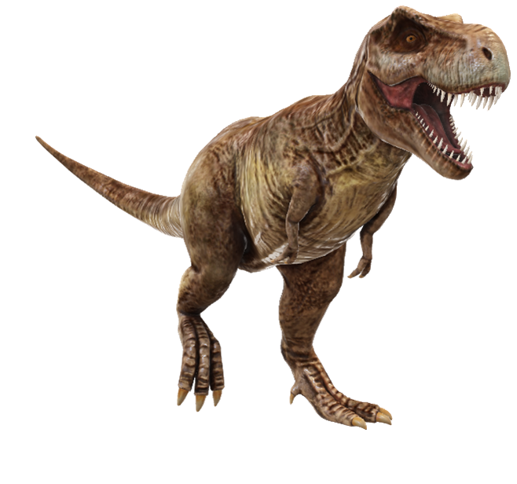

Slide 2
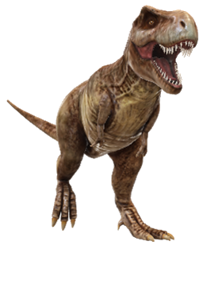
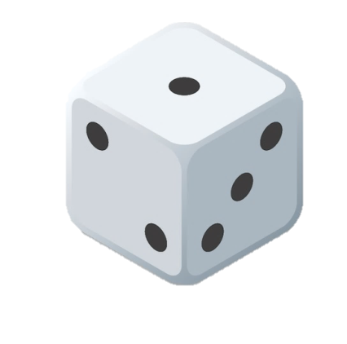
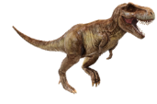
Click on this T-Rex if you catch the runner
CLEAR
CLEAR
Escaped!

Slide 3
Press ‘Esc’ to exit

