Slide 1
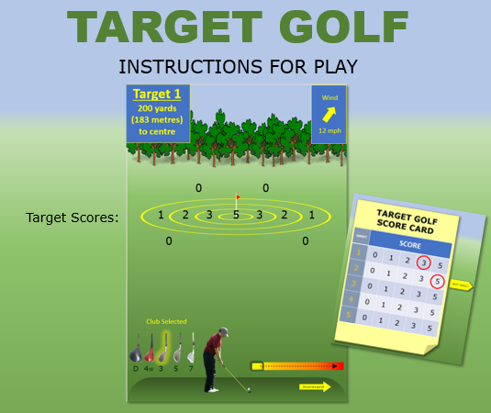
Check the distance to the target, the speed and direction of the wind and the club selected for the shot. (Keep these in mind to help you judge how much power to put into the shot).
Click on the golfer when you are ready to make the shot. As soon as you click on him, the box on the power-selection bar will start to move to the right (further right = the more power to the shot)
When you think the box has reached the right amount of power, double-click on the golfer again to make the shot
You can keep your eye on the ball to see where it lands and a yellow flag will appear to show you where the ball has landed as well. Your score will also be shown.
Click on the arrow to go to your scorecard, click on your score and then click on the arrow to move on to the next target.
START

Slide 2
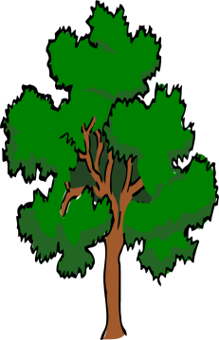
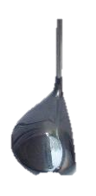
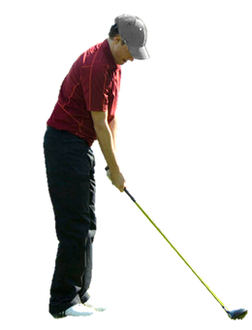
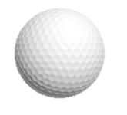
Target 1
200 yards
(183 metres)
to centre
Wind
12 mph
Club Selected
D 4W 3 5 7

Slide 3
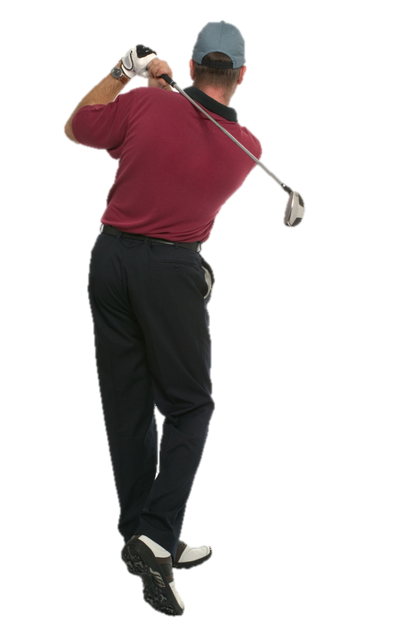
Target 1
200 yards
(183 metres)
to centre
Wind
12 mph
0
SCORE
Scorecard

Slide 4
Target 1
200 yards
(183 metres)
to centre
Wind
12 mph
0
SCORE
Scorecard

Slide 5
Target 1
200 yards
(183 metres)
to centre
Wind
12 mph
1
SCORE
Scorecard

Slide 6
Target 1
200 yards
(183 metres)
to centre
Wind
12 mph
2
SCORE
Scorecard

Slide 7
Target 1
200 yards
(183 metres)
to centre
Wind
12 mph
3
SCORE
Scorecard

Slide 8
Target 1
200 yards
(183 metres)
to centre
Wind
12 mph
5
SCORE
Scorecard

Slide 9
Target 1
200 yards
(183 metres)
to centre
Wind
12 mph
2
SCORE
Scorecard

Slide 10
Target 1
200 yards
(183 metres)
to centre
Wind
12 mph
1
SCORE
Scorecard

Slide 11
Target 2
150 yards
(137 metres)
to centre
Wind
3 mph
Club Selected
D 4W 3 5 7

Slide 12
Target 2
150 yards
(137 metres)
to centre
Wind
3 mph
0
SCORE
Scorecard

Slide 13
Target 2
150 yards
(137 metres)
to centre
Wind
3 mph
1
SCORE
Scorecard

Slide 14
Target 2
150 yards
(137 metres)
to centre
Wind
3 mph
3
SCORE
Scorecard

Slide 15
Target 2
150 yards
(137 metres)
to centre
Wind
3 mph
5
SCORE
Scorecard

Slide 16
Target 2
150 yards
(137 metres)
to centre
Wind
3 mph
2
SCORE
Scorecard

Slide 17
Target 2
150 yards
(137 metres)
to centre
Wind
3 mph
1
SCORE
Scorecard

Slide 18
Target 2
150 yards
(137 metres)
to centre
Wind
3 mph
0
SCORE
Scorecard

Slide 19
Target 2
150 yards
(137 metres)
to centre
Wind
3 mph
0
SCORE
Scorecard

Slide 20
Target 3
230 yards
(210 metres)
to centre
Wind
16 mph
Club Selected
D 4W 3 5 7

Slide 21
Target 3
230 yards
(210 metres)
to centre
Wind
16 mph
0
SCORE
Scorecard

Slide 22
Target 3
230 yards
(210 metres)
to centre
Wind
16 mph
2
SCORE
Scorecard

Slide 23
Target 3
230 yards
(210 metres)
to centre
Wind
16 mph
3
SCORE
Scorecard

Slide 24
Target 3
230 yards
(210 metres)
to centre
Wind
16 mph
5
SCORE
Scorecard

Slide 25
Target 3
230 yards
(210 metres)
to centre
Wind
16 mph
3
SCORE
Scorecard

Slide 26
Target 3
230 yards
(210 metres)
to centre
Wind
16 mph
1
SCORE
Scorecard

Slide 27
Target 3
230 yards
(210 metres)
to centre
Wind
16 mph
0
SCORE
Scorecard

Slide 28
Target 3
230 yards
(210 metres)
to centre
Wind
16 mph
0
SCORE
Scorecard

Slide 29
Target 4
120 yards
(110 metres)
to centre
Wind
20 mph
Club Selected
D 4W 3 5 7

Slide 30
Target 4
120 yards
(110 metres)
to centre
Wind
20 mph
1
SCORE
Scorecard

Slide 31
Target 4
120 yards
(110 metres)
to centre
Wind
20 mph
3
SCORE
Scorecard

Slide 32
Target 4
120 yards
(110 metres)
to centre
Wind
20 mph
5
SCORE
Scorecard

Slide 33
Target 4
120 yards
(110 metres)
to centre
Wind
20 mph
3
SCORE
Scorecard

Slide 34
Target 4
120 yards
(110 metres)
to centre
Wind
20 mph
2
SCORE
Scorecard

Slide 35
Target 4
120 yards
(110 metres)
to centre
Wind
20 mph
1
SCORE
Scorecard

Slide 36
Target 4
120 yards
(110 metres)
to centre
Wind
20 mph
0
SCORE
Scorecard

Slide 37
Target 4
120 yards
(110 metres)
to centre
Wind
20 mph
0
SCORE
Scorecard

Slide 38
Target 5
260 yards
(238 metres)
to centre
Wind
11 mph
Club Selected
D 4W 3 5 7

Slide 39
Target 5
260 yards
(238 metres)
to centre
Wind
11 mph
0
SCORE
Scorecard

Slide 40
Target 5
260 yards
(238 metres)
to centre
Wind
11 mph
0
SCORE
Scorecard

Slide 41
Target 5
260 yards
(238 metres)
to centre
Wind
11 mph
1
SCORE
Scorecard

Slide 42
Target 5
260 yards
(238 metres)
to centre
Wind
11 mph
2
SCORE
Scorecard

Slide 43
Target 5
260 yards
(238 metres)
to centre
Wind
11 mph
5
SCORE
Scorecard

Slide 44
Target 5
260 yards
(238 metres)
to centre
Wind
11 mph
3
SCORE
Scorecard

Slide 45
Target 5
260 yards
(238 metres)
to centre
Wind
11 mph
2
SCORE
Scorecard

Slide 46
Target 5
260 yards
(238 metres)
to centre
Wind
11 mph
1
SCORE
Scorecard

Slide 47
TARGET GOLF SCORE CARD
TARGET | SCORE
1 | 0 | 1 | 2 | 3 | 5
2 | 0 | 1 | 2 | 3 | 5
3 | 0 | 1 | 2 | 3 | 5
4 | 0 | 1 | 2 | 3 | 5
5 | 0 | 1 | 2 | 3 | 5
NEXT TARGET
NEXT TARGET
NEXT TARGET
LAST TARGET
What’s your total score?
Want to try and beat it?
Press ‘Esc’ to exit and try again.

