Slide 1
Save Tiddles!!
10
Tons
Save Tiddles by moving your cursor along the
desert road – but don’t step off!!
Click here
To START

Slide 2
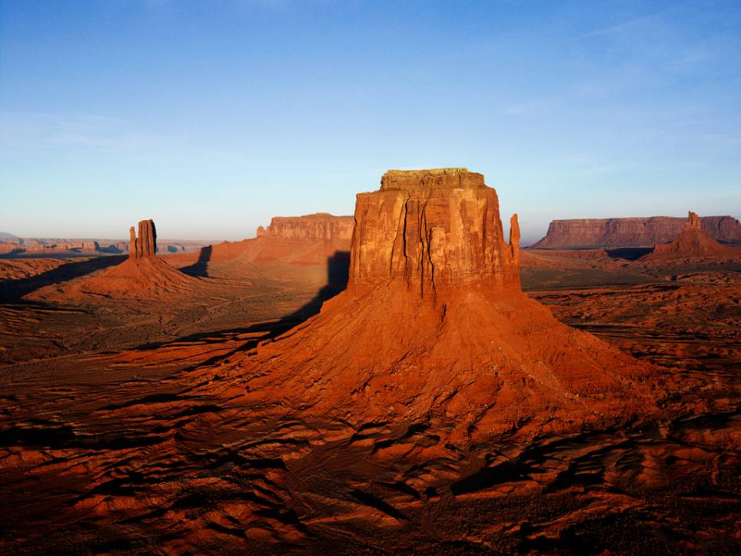
Save Tiddles!!
10
Tons
Save Tiddles by moving your cursor along the
desert road – but don’t step off!!
Click here
To START
And by the way, you’ve got One Minute!

Slide 3
Save Tiddles!!
10
TONS
Save Tiddles by moving your cursor along the
desert road – but don’t step off!!
Try again?
Click here

